Slide 1
Everything You Need to Know about the Exciting New World of The Digital Trackway
And Why It Is So Vital for the Philippines’ Social, Political and Economic Progress and Development

Slide 2
For any country in the world to attain its social, political and economic progress and development, it needs to build and institutionalize a Nationwide Logistics Backbone in order to efficiently, economically, and continuously mass transport people, agricultural goods, fisheries, and other cargo products.

Slide 3
I. The Origin of Train
The word train comes from the Latin word trahere, meaning “to pull” or “to draw”.
II. The Three Words in Railroad Track
The Rail, the Road, the Track
The operative word is Track
As we will show and explain, what makes a Railroad Track operationally efficient is NOT the Rails but the Track.
III. It is not the Railway but the Trackway
Trahere or pulling can be done on either a Railway (a trackway with rails) or a Trackway

Slide 4
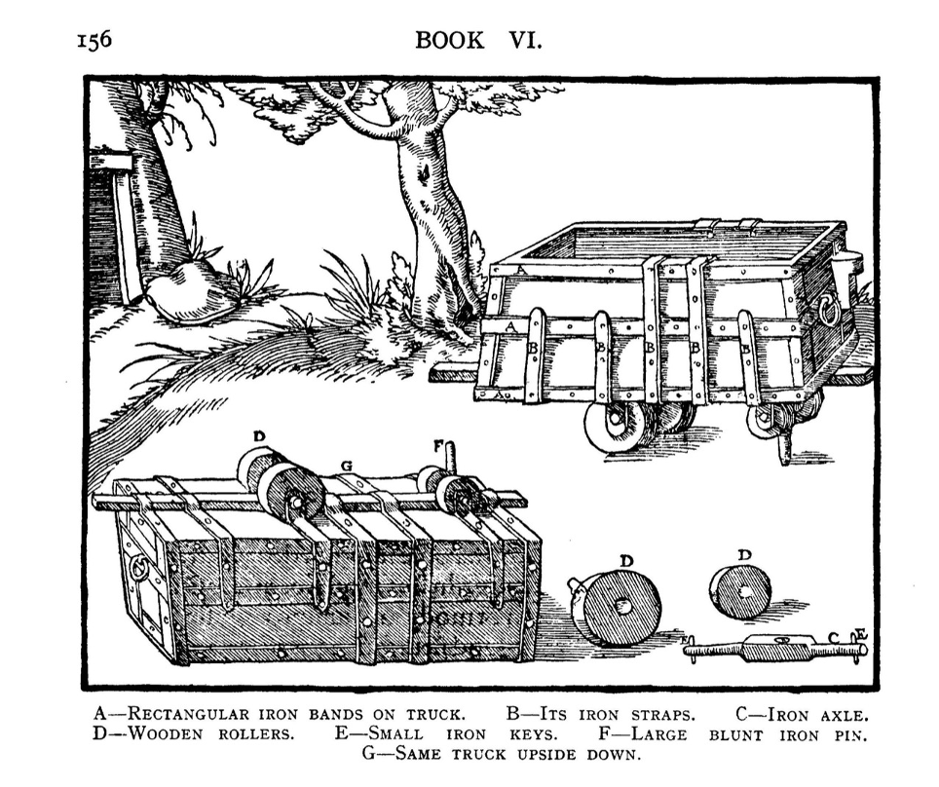
Shown below is a 1550 depiction of a wooden train with wooden rollers in order to pull or draw the train.

Slide 5
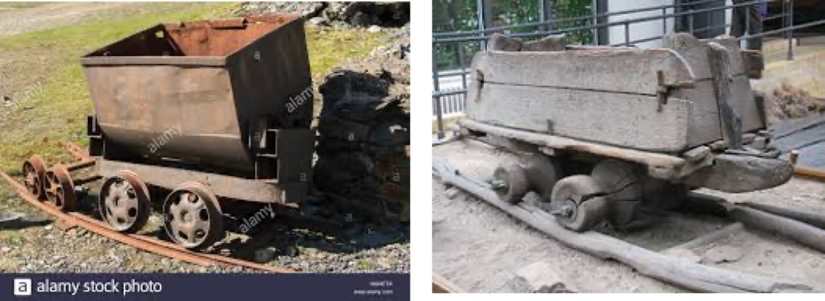
These wooden trains were pulled by men, donkeys, or horses being rolled on wooden planks to bring ores to and from mines. These were widely used in Austria and Germany in the 1550’s.
A more modern version is the 1845 steam locomotive from the United Kingdom. However, the first steam engine was built as early as 1784 by Scottish inventor, William Murdoch.

Slide 6
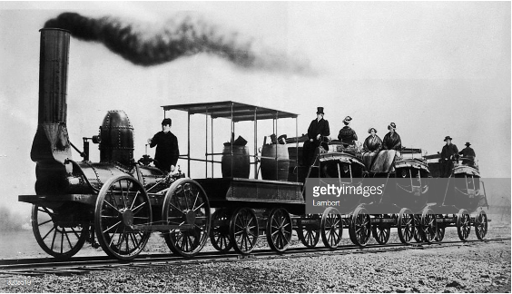
To better appreciate this picture, please bear in mind that the first paved road in Europe only started in 1858 on the Champ Elyses in Paris.
As you will notice, this steam locomotive which was first produced in 1807 in the United Kingdom is traveling on rails due to the invention of the wrought iron by an Englishman named John Birkinshaw in 1820.

Slide 7
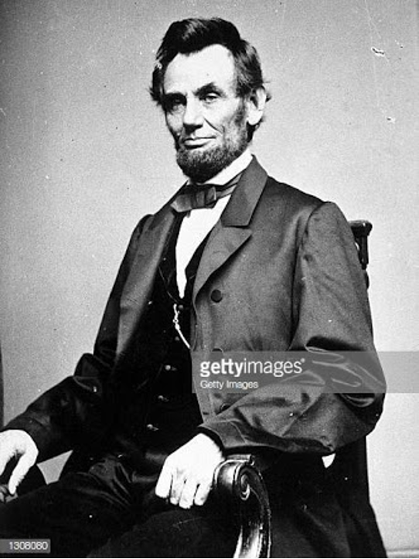
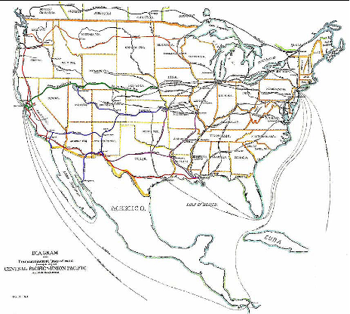
Much later in 1855, another Englishman named Henry Bessemer invented the mass production of steel called the Bessemer pneumatic steel production process.
Newly elected 1861 USA President Abraham Lincoln already knew that in order to trail blaze social, political, and economic opportunities across the just emerging USA, the USA needed a logistical backbone in order to immediately, efficiently, and economically mass transport its people and cargoes across the country.

Slide 8
Thus, even after the ravages of the civil war, President Lincoln was successful in convincing the USA Congress to enact The Pacific Railroad Act of 1862.
Accordingly, from 1863 up to 1869, the USA built a 1,912 mile (3,077 km) transcontinental coast-to-coast railway across the great USA.
It was only later in 1870 that the USA built its first asphalt road in Newark, New Jersey. Understandably, there were yet no Road Trains yet at that time.

Slide 9
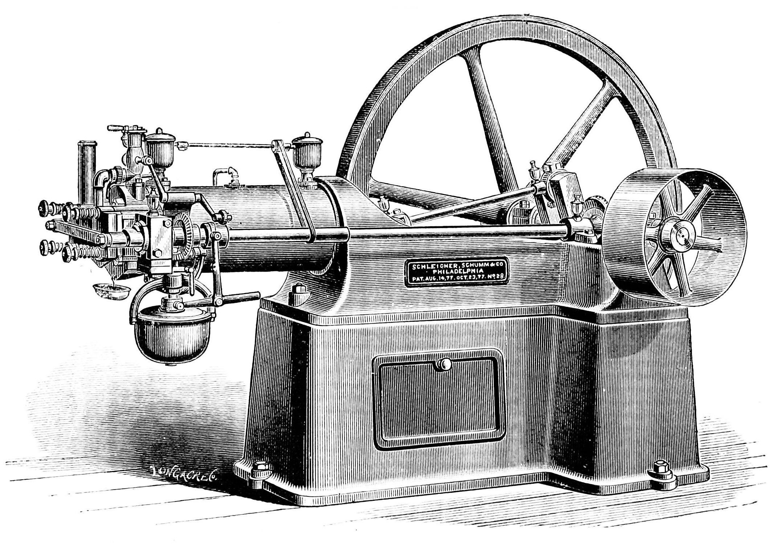
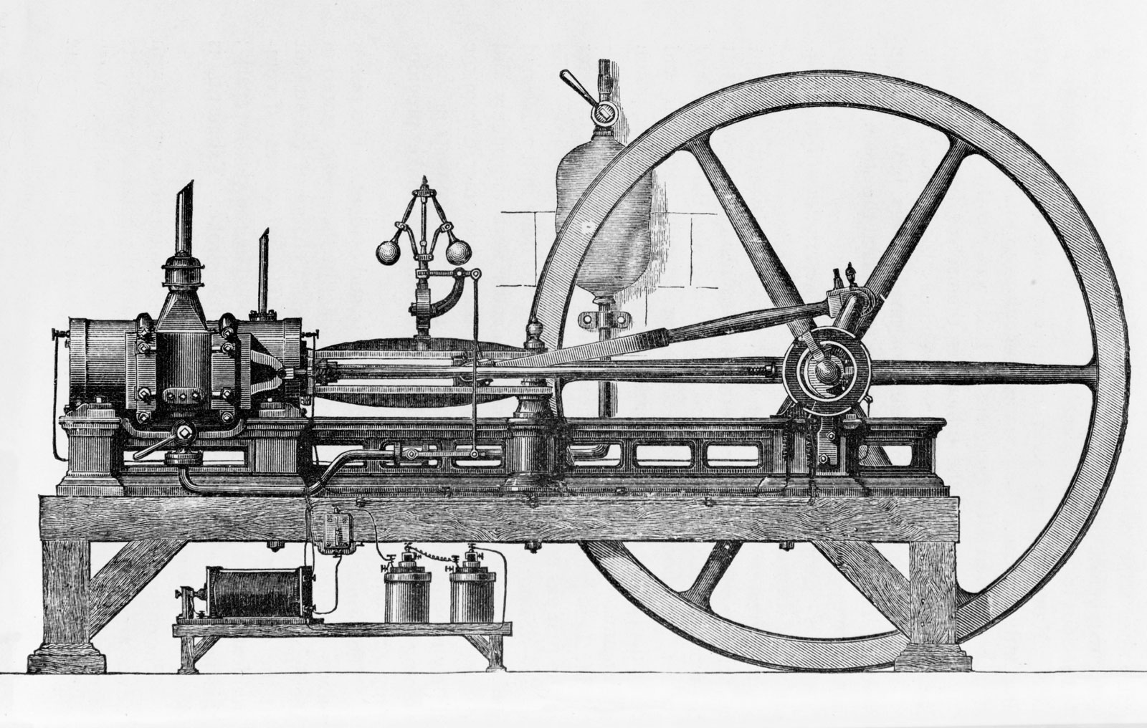
The first commercially successful internal combustion engine was created by Étienne Lenoir in 1859 and the first modern internal combustion engine was created in 1876 by Nicolaus Otto (see Otto engine).
Engine by Lenior
Engine by Otto

Slide 10
Because of this strategic logistical backbone, the USA was able to immediately, efficiently and economically mass transport its people and goods practically all over the USA.
What was followed was of course, the social, political, and economic boom and growth of the USA.
But even at that time, because of the unsustainable operating and maintenance costs of the railways, after nine years the various railroad companies started losing money.
The 1925 to 1935 Great Depression made it worse for Railroad companies.

Slide 11
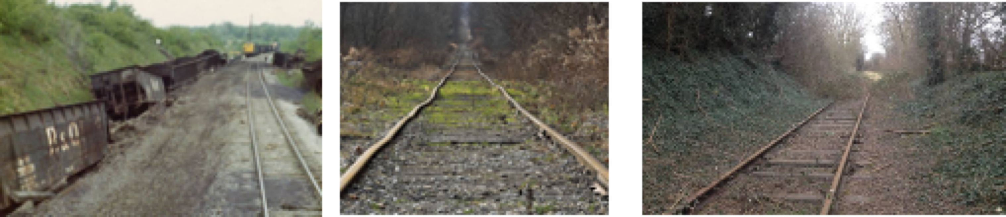
By 1937, 70,000 miles of USA Railroads were under Receivership.
Today, there are currently 1,342 bankrupt and abandoned Railways just in the USA alone.
There are thousands more abandoned and bankrupt railways around the world.
All Railways including the heavily used Singapore and the Hong Kong MTRs are losing propositions.

Slide 12
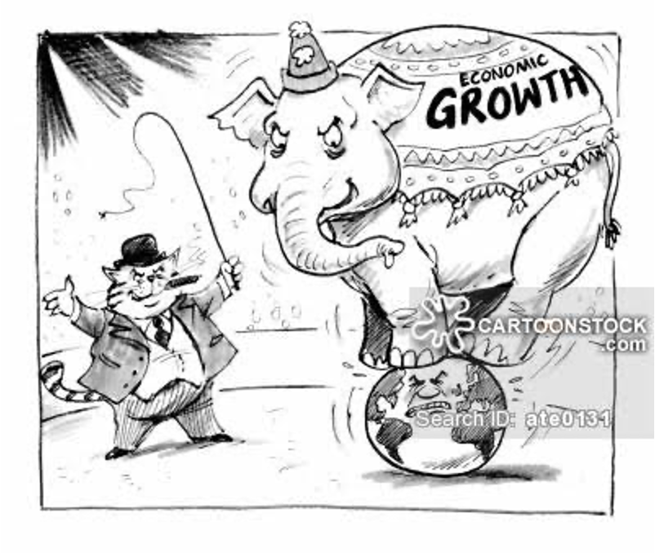
They are only sustained because the governments around the world literally force their citizens to subsidize them for the benefit of Railroad companies.
All Railways are financed with predatory terms.

Slide 13
The effective interest rates of railway financing can exceed 300% per annum as all foreign exchange risks are unjustly passed on to the borrowing country.
All Railways need sovereign guarantees and perpetual subsidies from taxpayers who are denied their own benefits.
Value-added in terms of raw materials, finished goods, spare parts, maintenance, even labor and consultants specially profits always favor exporting countries.

Slide 14
Effective Interest Cost of LRTs in the Philippines:
Effective %
    LRT 1
    500%
    LRT 2
    115%
    MRT 3
    100%
    +$15.0M/month

Slide 15
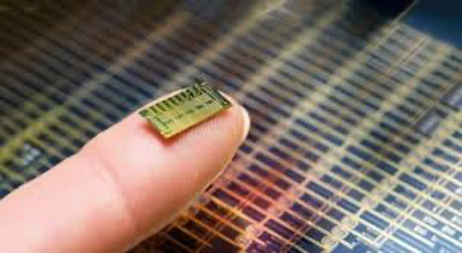
In 1981, Diosdado or Dado Banatao, a Filipino engineer born and raised in poverty in Malabac, Iguig, Cagayan. He was so poor he had to walk barefoot everyday to school; developed the first 10-Mbit Eithernet CMOS with a silicon coupler data-link control and transceiver chip.
His invention, popularly known as the Microchips forever changed and immensely improved the world as it has never been. Because of this Filipino icon, we now have the iPhone, iPad, Smart TVs, the Internet, GPS, Waze, PayMaya, artificial intelligence and limitless number of apps, as we have never known before.

Slide 16
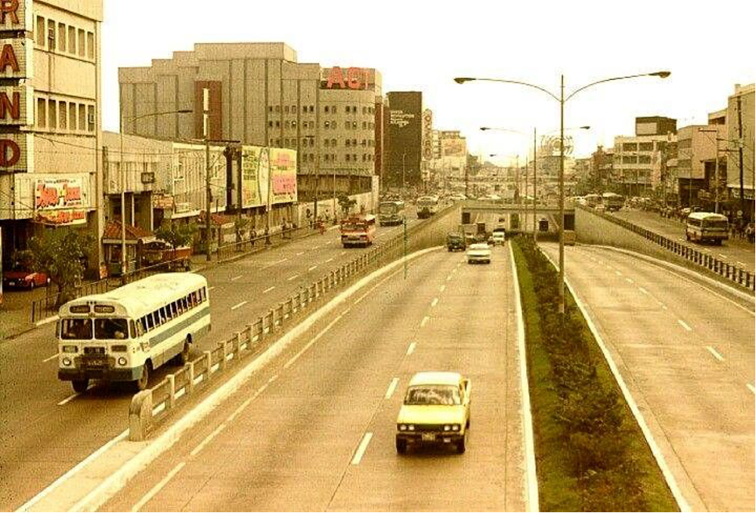
In 1990, inspired by Filipino icon Dado Banatao, a group of Filipinos — inventor and investment banker, transport and traffic and civil engineers, information tech experts, proposed to install and operate the first Philippine Rapid Digital Trackway (PRT), now simply, Trackway initially along the PNR and similarly along the then unoccupied middle island of EDSA.
The UP Transport Training Center (UPTTC) which is now the National Center for Transport Studies (NCTS) showed that only 96 articulated bus trains operating along the unoccupied middle island of EDSA would be needed to transport 1,054,000 passengers a day.

Slide 17
They were rejected as their Digital Trackway was.
Tagged as “unproved, merely theoretical and with only a limited systems capacity.”
They tried again to install it on the wide and very long 1,100 km wasting away Trackway of the PNR.
They were rejected again.
Learning about the Digital Trackway, World Bank Transport Expert Gerhard Menckhoff flew to the Philippines to learn more about the Digital Trackway.
On April 30, 1990 the World Bank issued an Internal Memorandum recommending the implementation of the Digital Trackway not only in the Philippines, but worldwide.

Slide 18
In 1990, there were no search engines yet for the Philippines or even the World Bank to know that a similar but limited system was already successfully operating in Curitiba, Brazil.
It was limited as it only mass transported people within city limits.
The Digital Trackway has always been designed not only to mass transport people but agriculture, fisheries, and other cargo within cities and across countries and even continents.
On October 15, 1997 after another in-depth and exhaustive study, a historic moment happened in the Philippines and eventually global mass transit history.

Slide 19
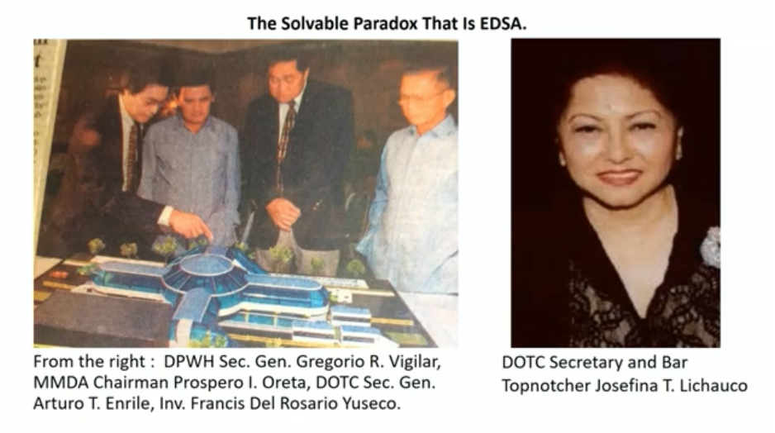
The Philippine Government then under the President Ramos administration approved for implementation the Digital Trackway along two major corridors of Metro Manila — the still unfinished C5 Corridor and Commonwealth Avenue.
Signatories for the Philippines were DOTC Secretary Arturo T. Enrile, DPWH Secretary Gregorio R. Vigilar and MMDA Chairman Prospero I. Oreta. After Secretary Enrile untimely demise, his successor bar topnotcher Secretary Josefina T. Lichauco signed the Digital Trackway’s Implementation Plan.
The signing was reported in all the front pages of the leading newspapers in the Philippines.

Slide 20
Regrettably, on account of the 1998 Asian Financial Crisis, the launching of the Digital Trackway had to be deferred to a more propitious time.
The front page new caught the attention of the United States Federal Transit Authority (USFTA) through the American Bus Association (ABA).
A series of communications then started between the Trackway Consortium and the ABA.
On August 31, 1999, the ABA President Georg Wynn suddenly sent a facsimile letter to the Trackway Consortium. The letter announced that the USA then under President Bill Clinton was also going to reinvent bus service in the United States, the features and operating characteristics were similar to the PRT.

Slide 21
USFTA Administrator Gordon Linton tagged the newly reinvented bus service with the catchy but grammatically wrong Bus Rapid Transit or BRT.
With the mighty USA now leading the BRT, instead of the Philippines leading the city operated PRT or the Cross country Trackway, there are now 180 cities in 39 countries successfully operating their own PRTs/BRTs.
These PRTs/BRTs transport as much as 1,000,000 to 1,800,000 passengers per corridor per day covering distances as long as 300 kilometers up to 482 kilometers.
Likewise, as provided for in the PRT and/ or Trackway Intellectual Property Rights as early as 1989, some of these PRTs/ BRTs are elevated.

Slide 22
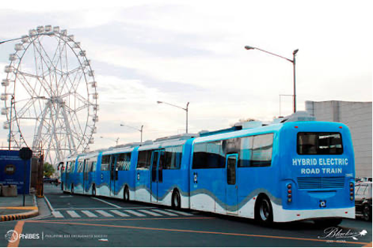
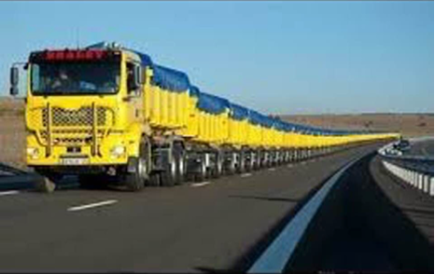
Common sense dictates three simple facts as envisioned by the Philippines as early as 1989: a) If these PRTs/BRTs can mass transport people, they can also mass transport agri, fisheries and other cargoes in both refrigerated and none refrigerated Road Trains; b) if they can travel as long as 482 kilometers one way, so long as the ROWs are available, they can travel longer; c) If the corridors are narrow, their carriageways can be widened or elevated.
In 2012 our very own DOST Metals Industry Research and Development Center ( DOST-MIRDC) started developing the Philippines locally produced Road Trains.

Slide 23
In 2017 a very important international transport study conducted by Technical University of Denmark published in Transport Reviews by researchers Jesper Ingvardson and Otto Nielsen revalidated the three earlier Philippine Studies.
That the operating efficiency of Trackways and Road Trains operated digitally within a “ completely controlled therefore completely Programmable environment “ has the same operating efficiency as centrally controlled and programmed railways and rail trains.
In the same year another study conducted by the Boston Consulting Study Group again validated the Trackway Consortium’s 1989 Conclusion: That no matter how many LRTs, MRTs, Railways and Subways are installed in cities, so long as economic opportunities are not trail blazed throughout the country, cities will always remain congested.

Slide 24
In 2017 the Trackway Consortium and the DOST started discussions on how we Filipinos can join forces in order to help the country finally embark on its long delayed path towards Industrialization and Exportation.
In 2017 China also launched its first railless Road TraIn the same year, because of mounting debts and losses losses to its Railways, China also stopped the construction of three (3) already approved subways.
Just to disabuse everyone’s mind that Trains do not necessarily have to run on rails, here are two pictures of two 100 meters and 140 meters long Road Trains that have been transporting various cargoes in the Outback of Australia on Roads.

Slide 25
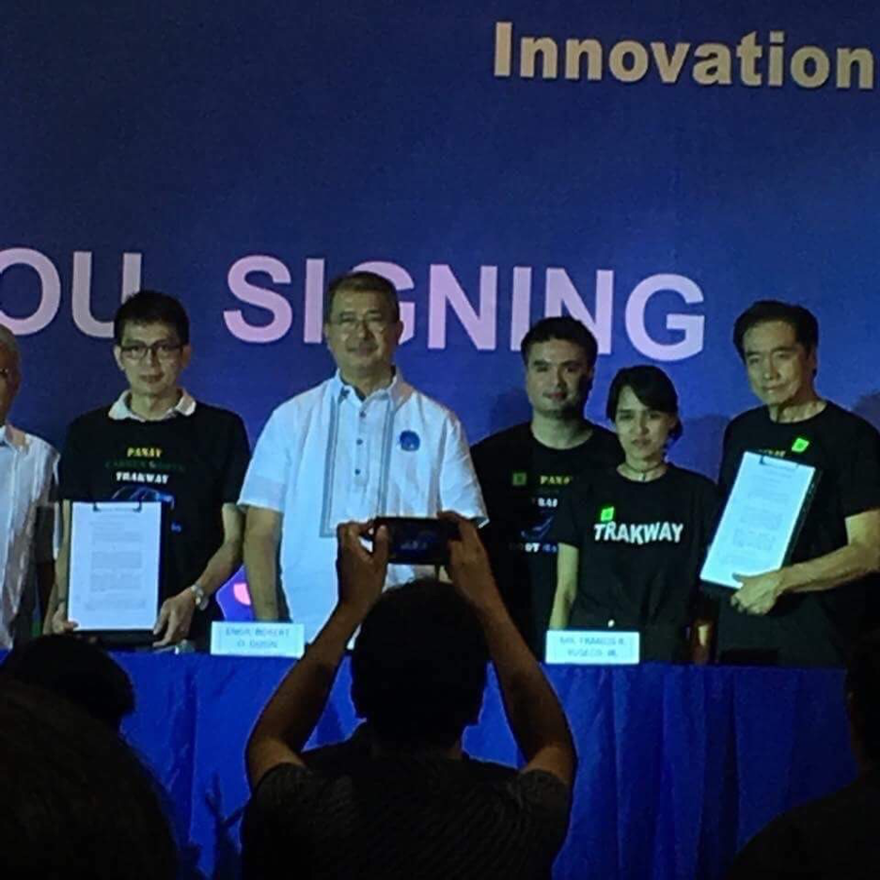
On July 19,2018, the DOST, Panay Railways , Inc. and Philtrak, Inc. signed and formed a strategic alliance to convert the 35 year old decommissioned Panay Railways into the Philippine Digital Trackway operating DOST Hybrid Electric Road Trains.

Slide 26
On May 2018 Malaysian Prime Minister Mahathir Bin Mohamad ordered the scrapping of the 350 km. High Speed Rail from Malaysia to Singapore for being too costly.
Malaysia’s Economic Advisers advised PM Mahathir that the US$ 52.0 Million price per kilometer was too prohibitive.
Most Malaysians even the wealthier ones would not be able to afford the one way ticket price of US$ 48.00 or P2,505.60.
Applying the same computation to the PNR’s US$ 200.0 Million per kilometer, for its 148 km. distance, a one way ticket would cost P4,910.97 one way.
For the entire 650 km. the equivalent one way ticket price will be P8,594.18.

Slide 27
For the approved Metro Manila Subway, the same one way ticket for a distance of only 35 kilometers, will be a staggering and scandalous P13,026.31!!!
A comparative analysis of the cost per kilometer shows the following enormous and disturbing huge variances:
Malaysia/Singapore High Speed Railways - US $ 52.0 Million per Kilometer
Philippine National Railways - US $ 200.0 M
Metro Manila Subway - US $ 227.0 M
Philippine Exportable Digital Trackway - US $ 2.67 M
China’s Debt To GDP Ratio is An Incredulous 253%
Japan’s Debt to GDP Ratio is Also A Alarming 198%

Slide 28
The Philippines Debt to GDP Ratio May Be Manageable Still at 42%. However, 64% of our GDP are fragile as 52% consist of BPO “services” which are now being gradually replaced by AI and Robotics.
The other 12% still come from the social and familial sacrifices of our OFWs who are literally forced to seek employment overseas because of the sheer lacks of jobs in our own country.
Similarly, our Current Account and Trade Deficits are worsening when they need not be.

Slide 29
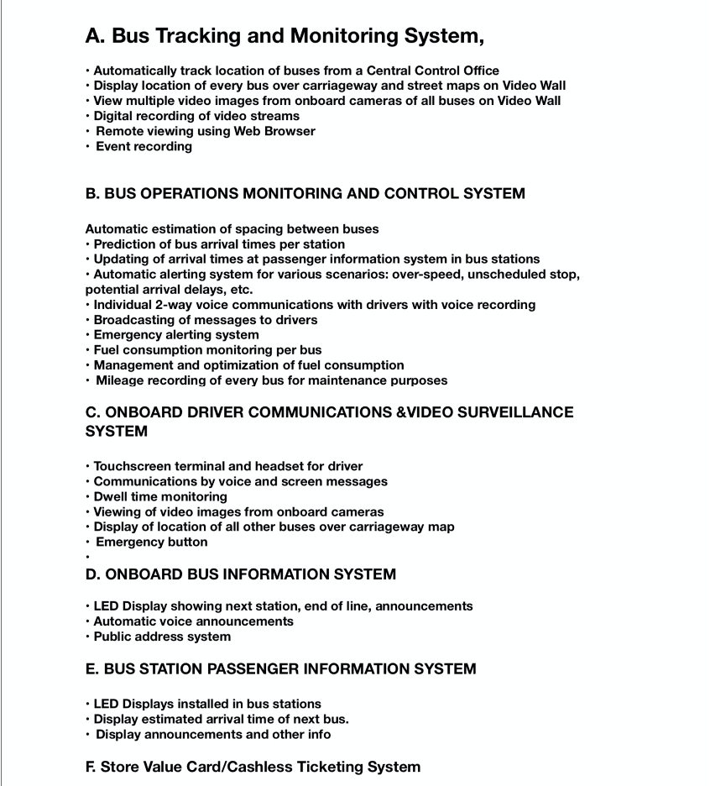
Information Technology Copyrighted and Patented Software Trackway System.

Slide 30
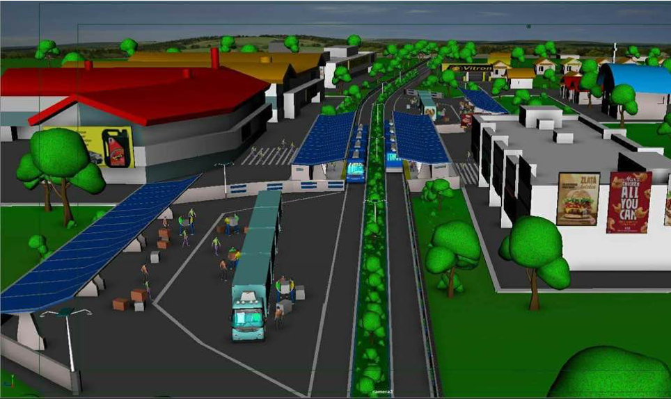
Main Objective Remains:
For the same cost of P393.0 Billion just to build a mere 36 km. Subway, we can build a 3,070 km. Nationwide Digital Trackway Operating Philippine made Road Trains that can physically link Luzon, Visayas and Mindanao within the next two to three years.
Shown here is a depiction of our long suffering farmers and fisher folks transferring their produce and catch so they can bring them directly to the urban outlets.

Slide 31
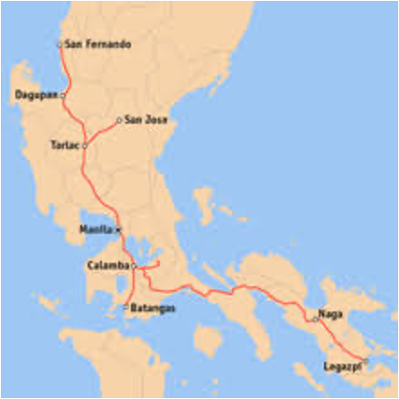
Shown also are the various real estate developments that the PNR can build within its 30 meters to 60 meters wide Trackway.
Section 2 Article IVX of our Constitution declares it a national policy to promote and prioritize the use of Philippine Science and Technology.
RA 8293 The Intellectual Property Code obligates all Filipino citizens led by government officials to prioritize the actual use and operations of duly registered and awarded Philippine Copyrights and Patents.

Slide 32
RA 4156 The PNR Charter does not restrict the PNR to operating only rail trains, it also allows it to operate road trains or even buses.
In fact, last August 6, 2018 the Duterte Cabinet already issued a Resolution to promote Philippine made Rail Trains, Road Trains and the Automatic Guideway Transit.
Thus, to the credit of DOTr Sec. Arthur P. Tugade and Undersecretary TJ Batan, they both assured us that in the event we would be ready to submit an Unsolicited Proposal a 1,100 km. Trackway on the at-grade level of the PNR, such proposal should be submitted direct to the DOTr and not the PNR.

Slide 33
But for now our Consortium will be more than happy to start with converting the Panay Railways and the Calamba to the Batangas railways into our Digital Trackway. Of course, the EDSA Digital Trackway remains on top of our list.
If at at some future time, the at grade level of the 1,100 kms. PNR railways can also be converted into our Digital Trackway, we working together as a nation, can attain the following:
Decongest all our cities
Solve out cities’ massive traffic and transport problems
Resettle its 600,000 informal settles with livelihood programs.
Save over P1.1 Trillion in foreign currency denominated loans.
Liberate billions of unnecessary yearly taxpayers subsidies.

Slide 34
Clean up all MM waterways and other bodies of water.
Empower Luzon based farmers and fisher folk.
Empower consumers.
Enhance the country’s food security.
Create hundreds of thousands of new jobs.
Boost up downstream industries in steel, metal, rubber, tries, glass, mirrors, plastic, textiles, etc.
Make Clark, Subic Airports and Batangas seaport immediately accessible.
Build the much-needed cell towers within the enclosed secured Trackway.
Broaden and increase the country’s tourism base.
Substantially reduce crime and drug problems.
Attain unprecedented levels of GDP growth.
Initiate the process of reverse migration.
Integrate Rebel Returnees into the Trackway system.
Transform the PNR from being a perpetual burden to the people and make it a reverse subsidy earning government corporation hence on.

Slide 35
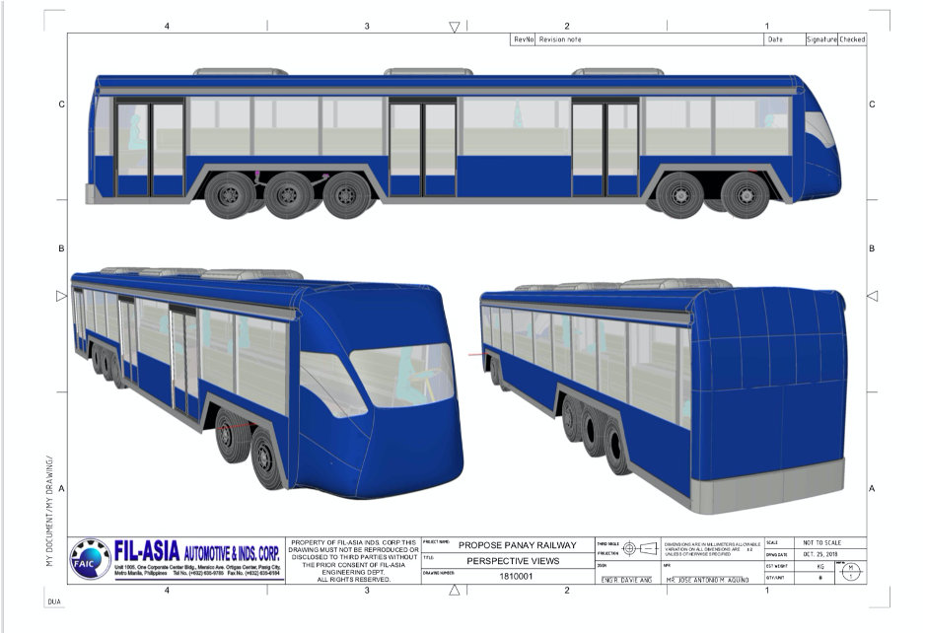
The DOST 17.5 Meter Road Train - Passenger and Cargo
Youtube Links:
https://youtu.be/VUZx19TN6Jw?fbclid=IwAR2Y9QCL5pn2TsBZSIvmKEeRgmV3MvEhyh7ORMXYmEp_C4qlH-NaG81TGFM

Slide 36
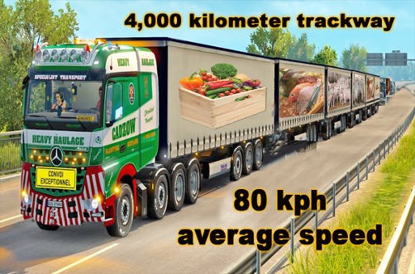
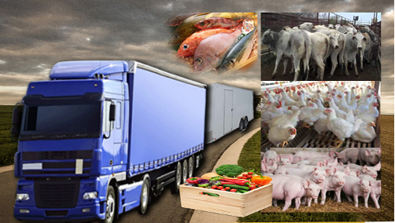
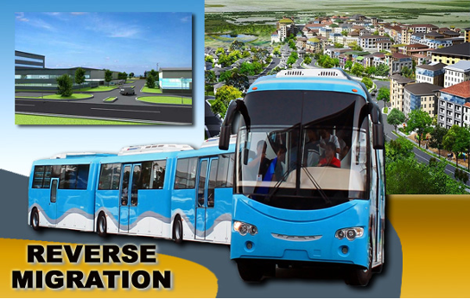

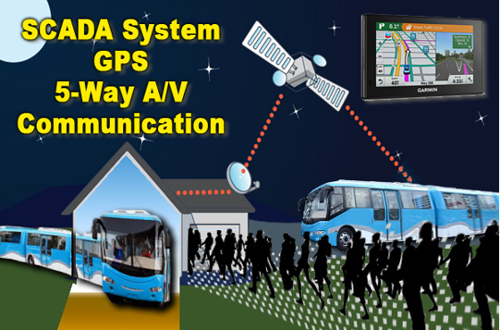
Nationwide Logistics Trackway

Slide 37
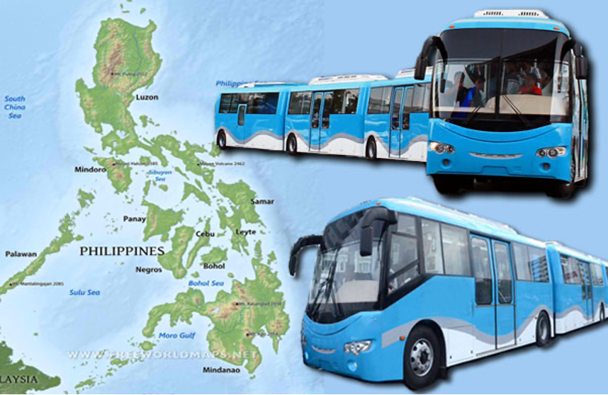
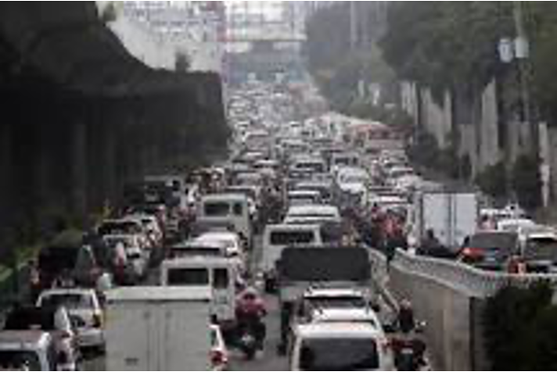
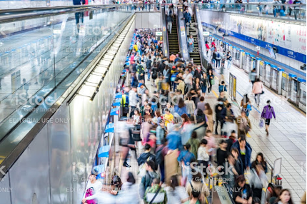
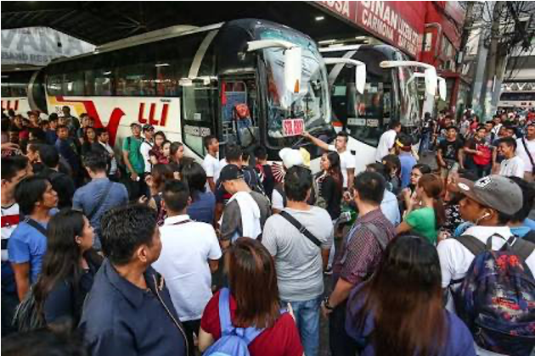
EDSA Rapid Trackway

Slide 38
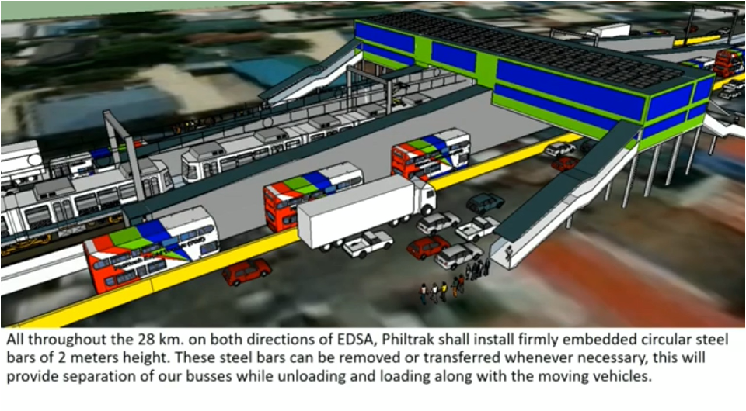
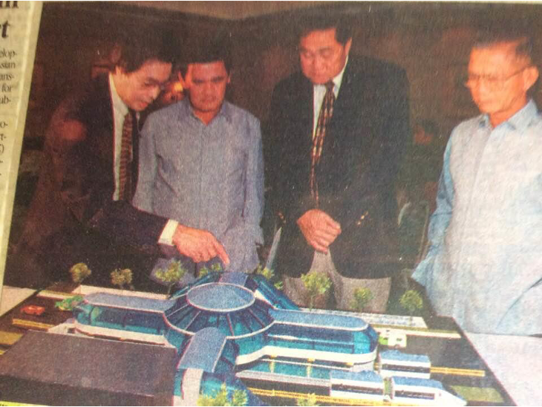
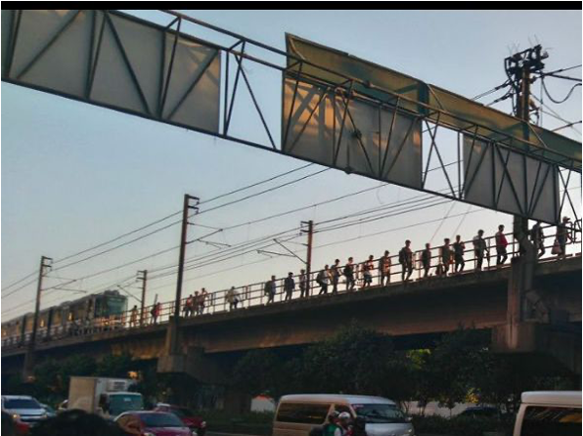
EDSA Rapid Trackway

Slide 39
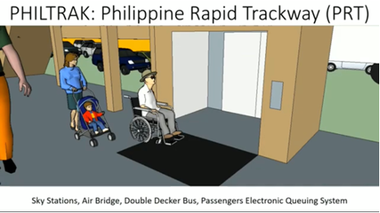
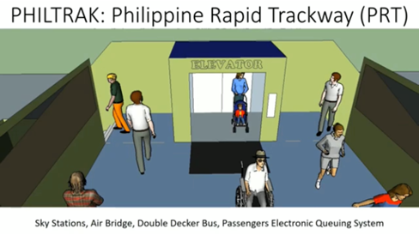
Digital Cross Country Trackway

Slide 40
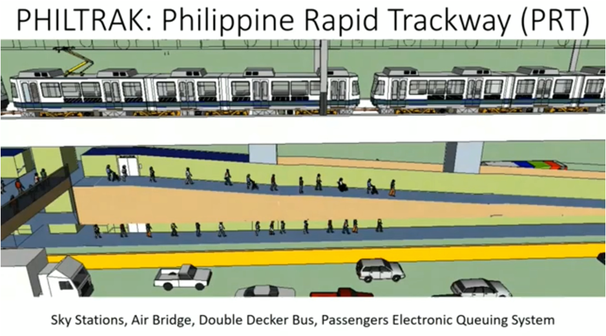
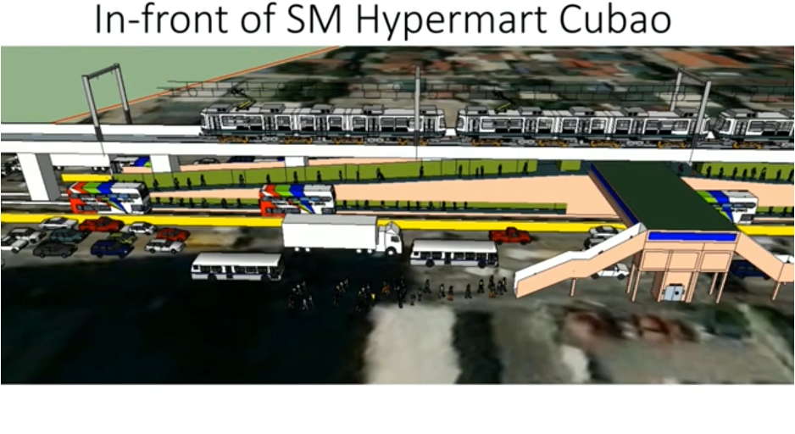
Digital Cross Country Trackway

Slide 41
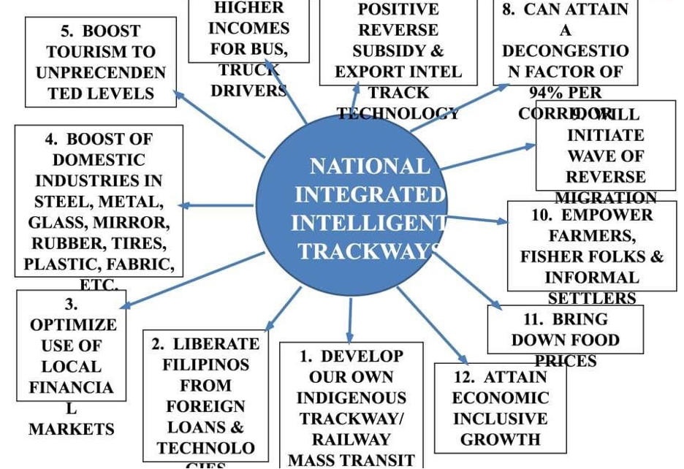
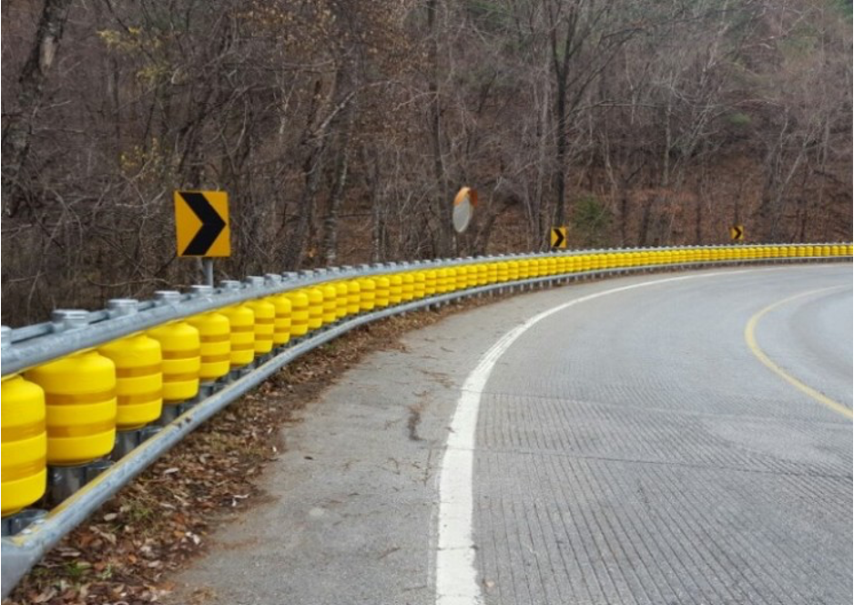
Digital Cross Country Trackway

Slide 42
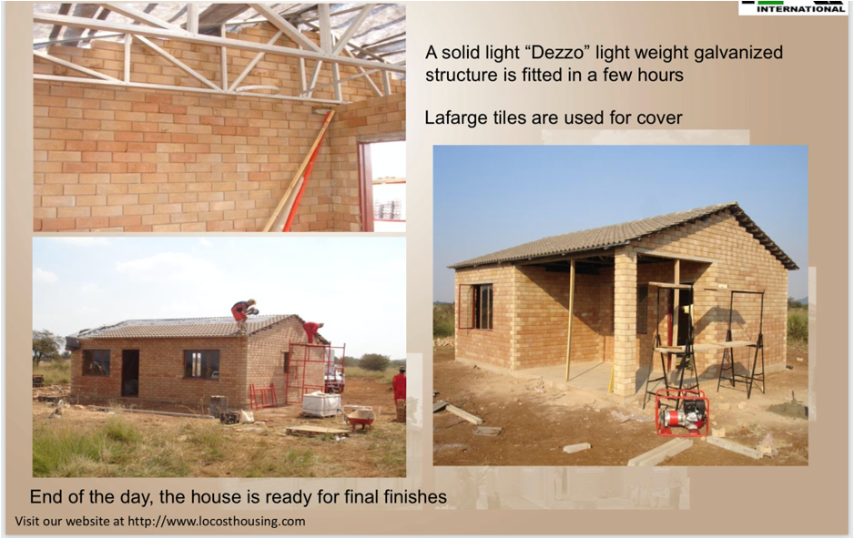
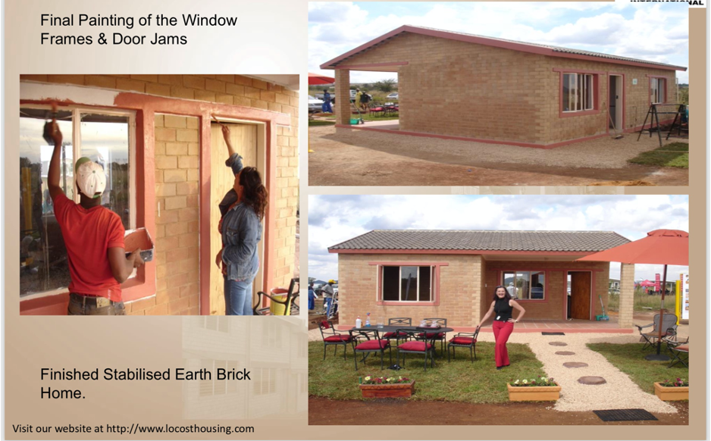
Digital Trackway Connecting the Entire Phippines including Physical Bridges
2 story 100 sq.meter house = P1,000,000.00h

Slide 43
Bataan-Cavite Interlink Bridge (28 km)
Mindoro-Batangas Super Bridge (15 km)
Camarines-Catanduanes Friendship Bridge (10.7 km)
Luzon (Sorsogon)-Samar Link Bridge (18.2 km)
Panay-Guimaras-Negros Link Bridge (19.2 km)
4th Mandaue-Mactan Bridge (0.42 km)
Cebu-Bohol Link Bridge (24.5 km)
Bohol-Leyte Link Bridge (22 km)
Leyte-Surigao Link Bridge (23 km)
Negros-Cebu Link Bridge (5.5 km)
Panguil Bay Bridge (3.77 km)
Guicam Bridge (0.44 km)
Davao-Samal Bridge (4.4 km)
Three Tawi-tawi Bridges spanning a total of 0.78 km

Slide 44
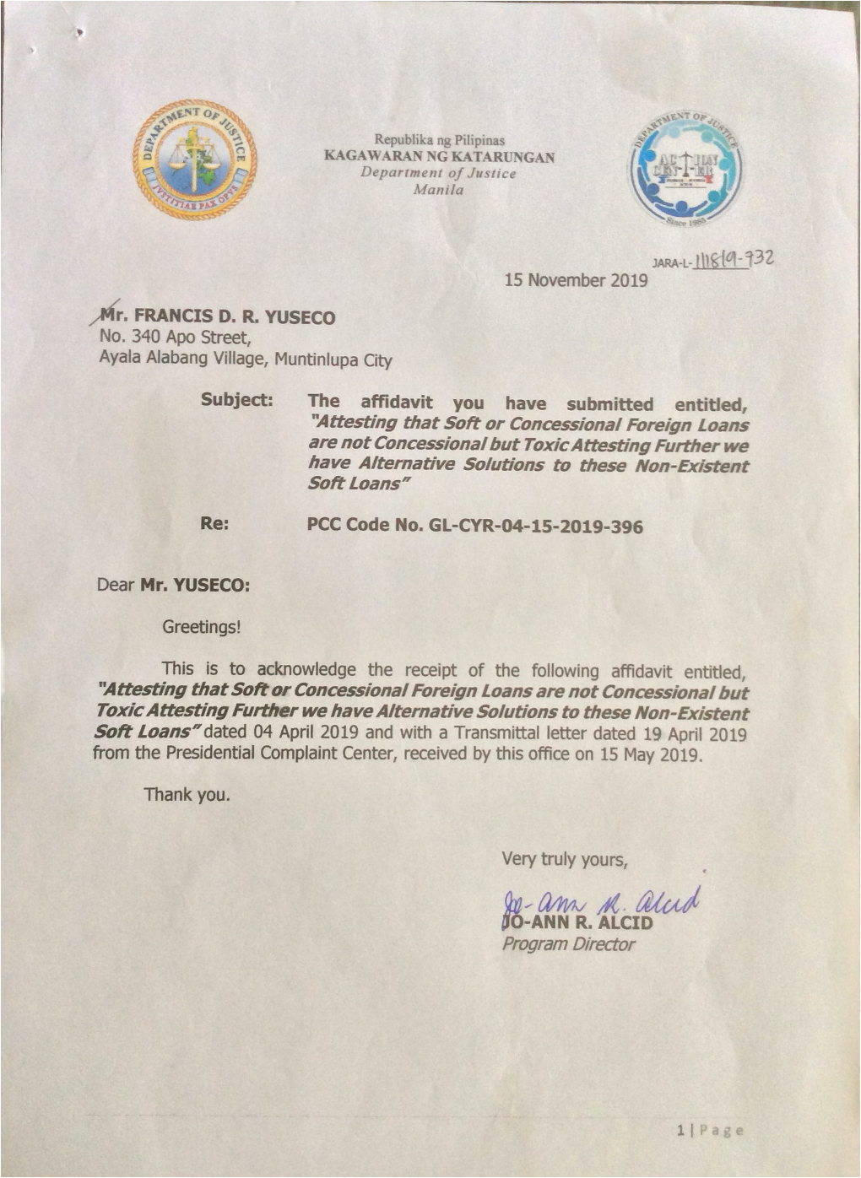

Slide 45
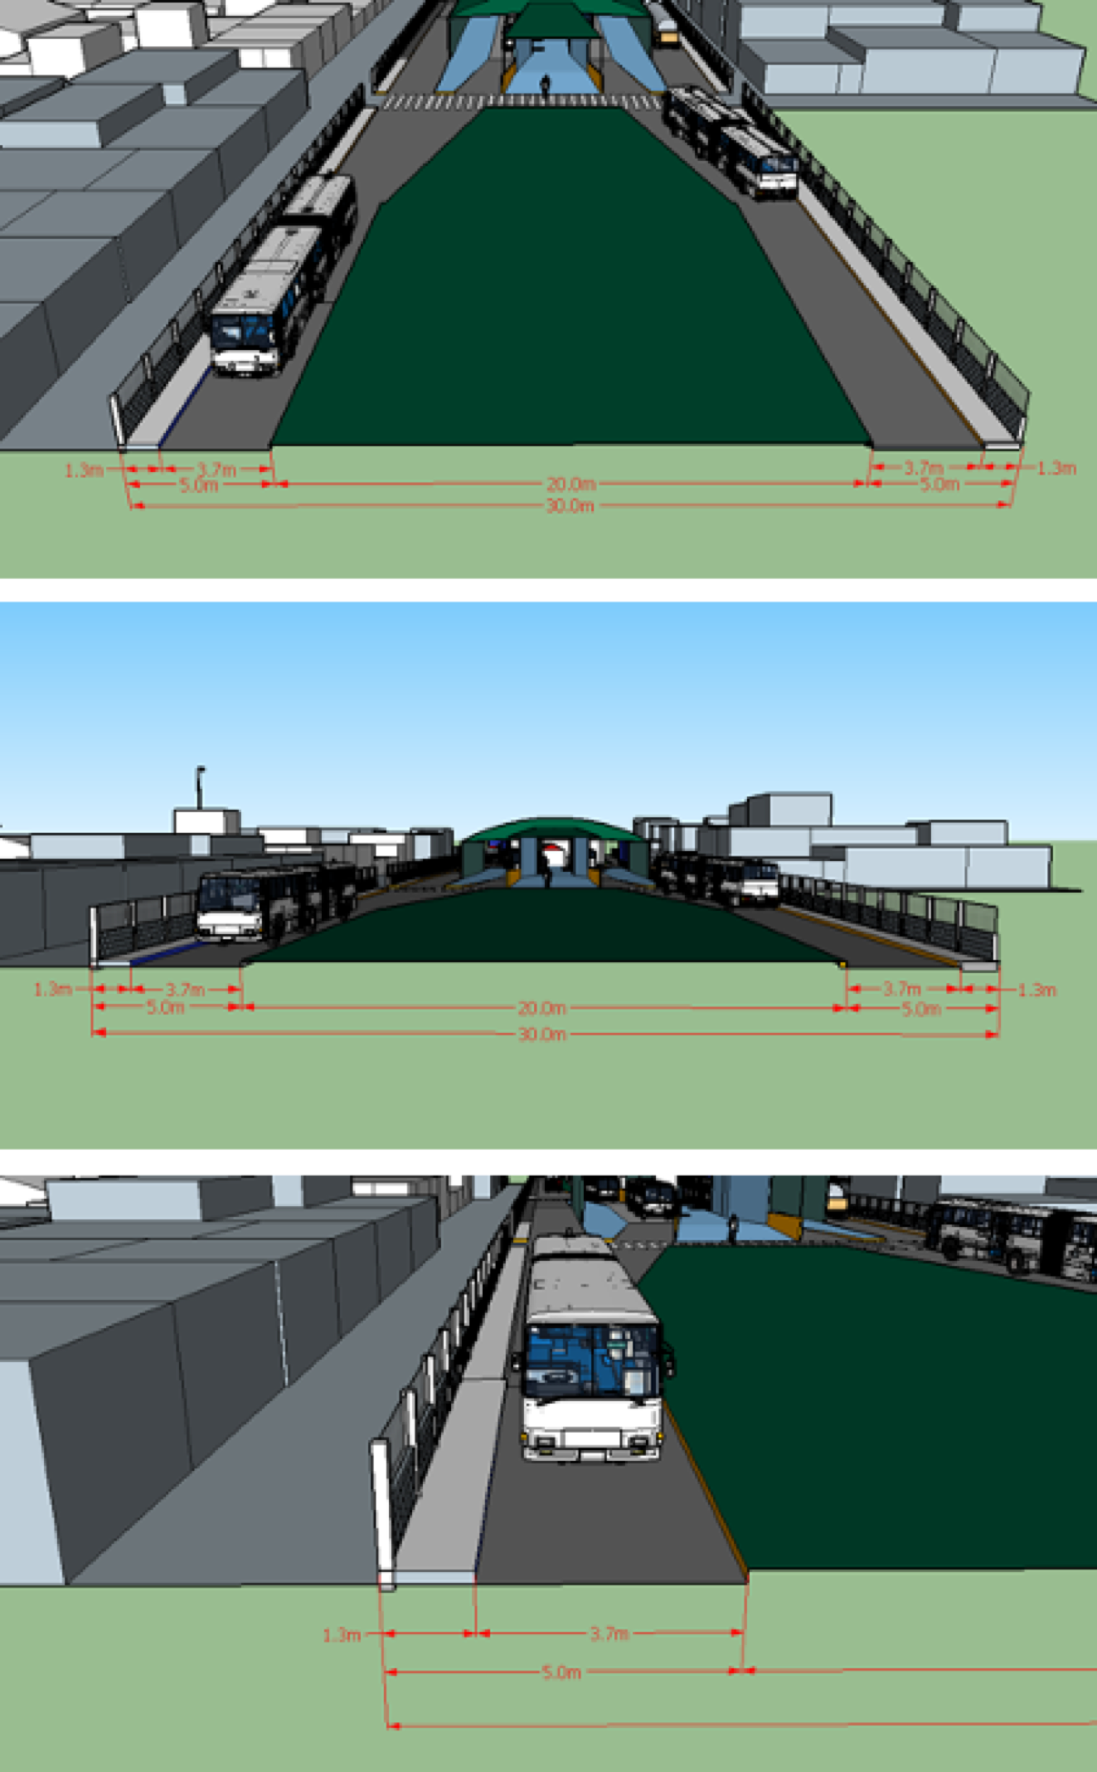

Slide 46
