Slide 1
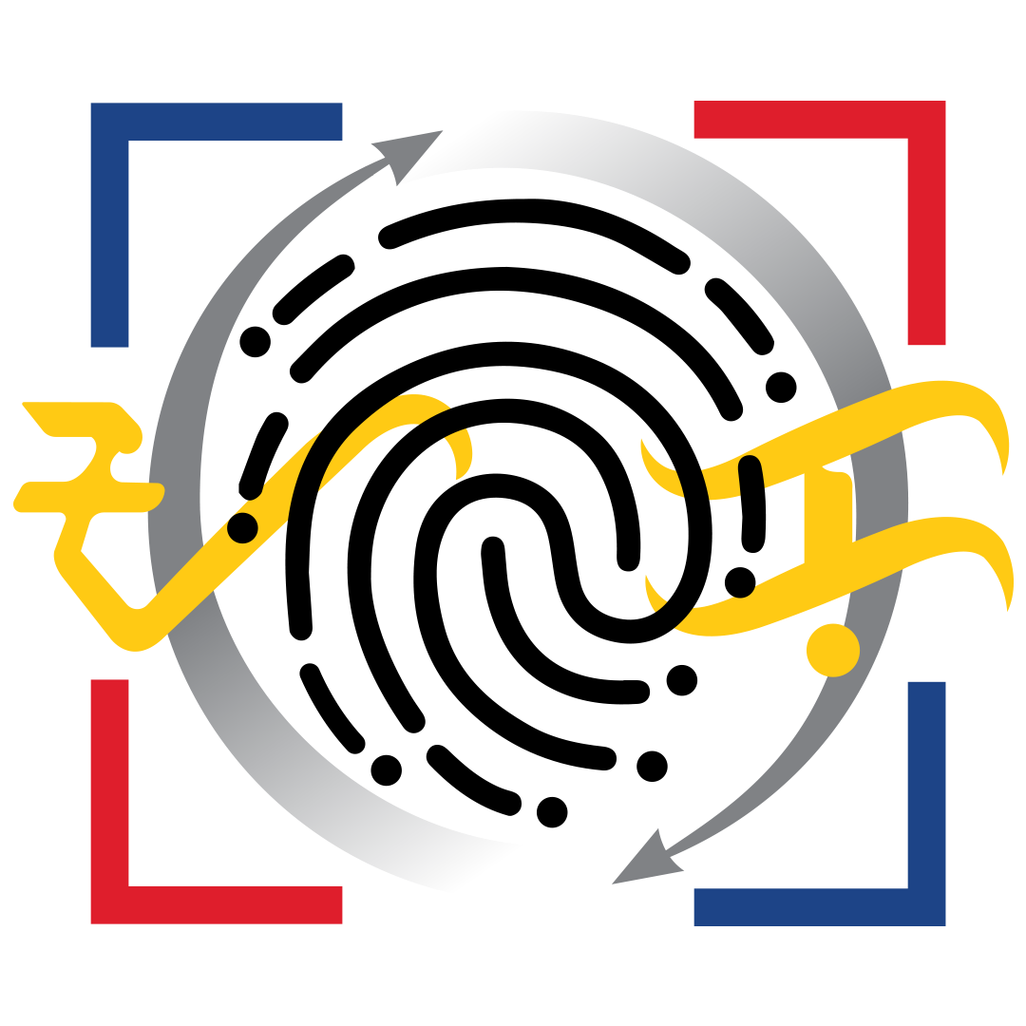
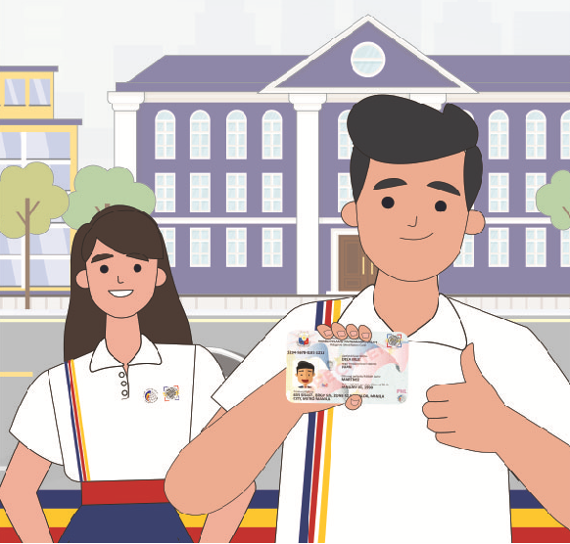
PhilID 101
(An Overview of the Card)
EMILY R. PAGADOR
OIC Assistant National Statistician
Use Case Development and Management Service
PhilSys Registry Office
PhilID 101: Webinar for PhilID Security Features and Authentication Framework
02 December 2021, 1:30 p.m. – 3:30 p.m.
.

Slide 2

The PhilID
Purpose
The PhilID card shall serve as the official government-issued identification document of cardholders in dealing with all national government agencies (NGAs), local government units (LGUs), government-owned or controlled corporations (GOCCs), government financial institutions (GFIs), State Universities and Colleges (SUCs), and all private sector entities.
Nontransferable card that shall preferably be issued to all citizens or resident aliens registered in the PhilSys subject to the guidelines to be issued by the PSA.
Fees
The initial application and issuance as well as the renewal of the PhilID for citizens shall be free of charge. Renewal shall pertain to the replacement of the PhilID arising from recapturing or updating of biometric information.

Slide 3
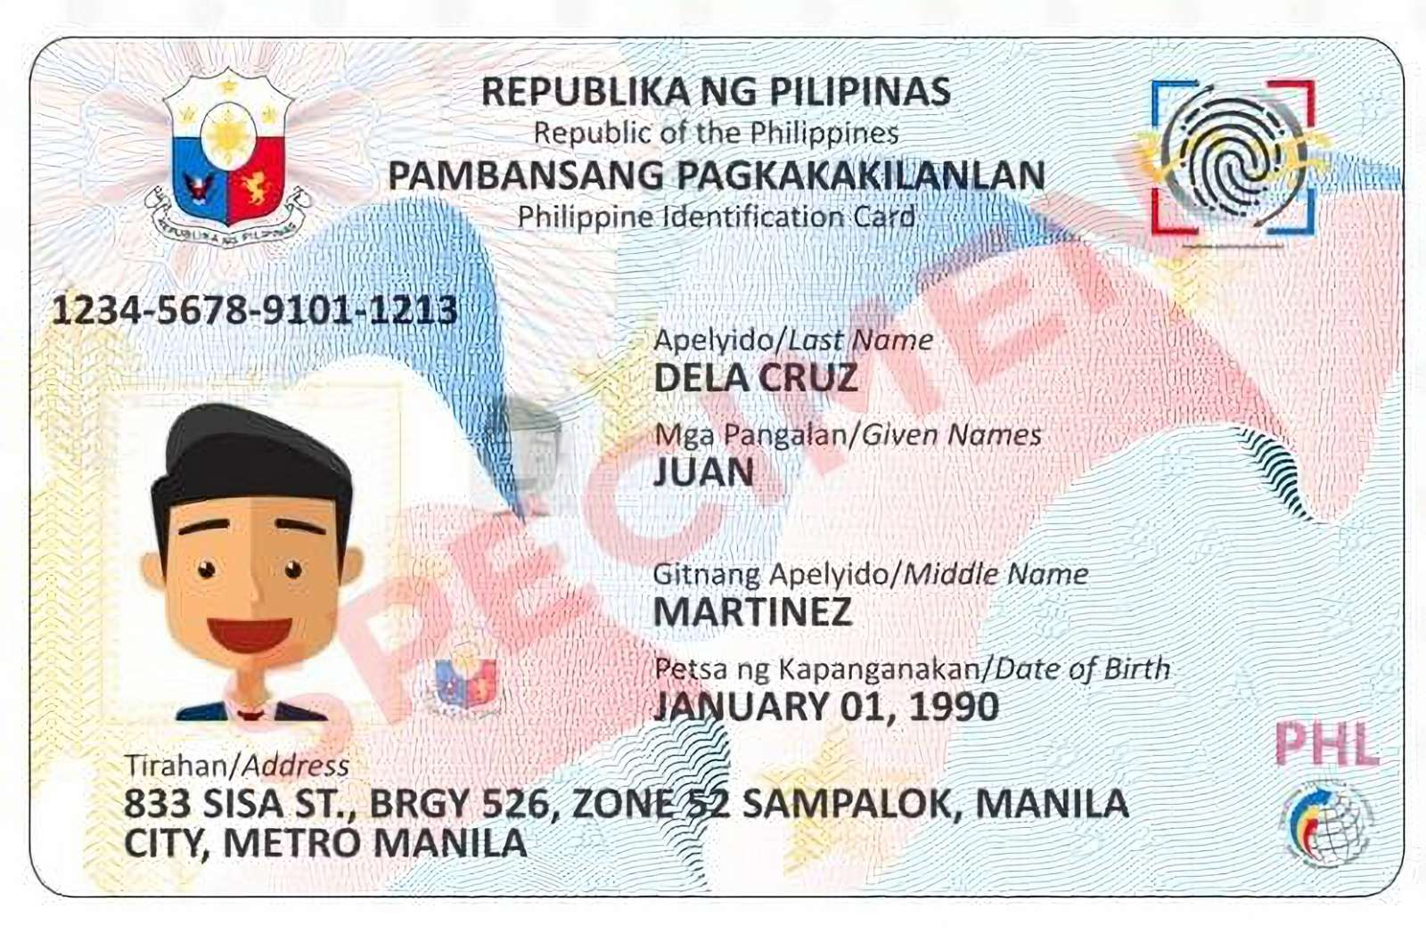
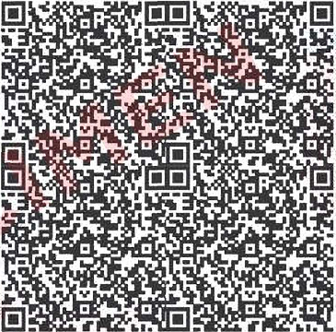
Features of PhilID
The PhilID shall be the physical medium issued to "convey essential information about the person's identity containing on its face his or her PSN, full name, sex, date of birth, place of birth, blood type, address, marital status (if declared), and a front facing photograph."
The PhilID shall have a QR code, which contains at least the PSN or its derivative and any two-fingerprint information. The PhilID shall also include other security features as safeguards for the data privacy and security, and prevention against the proliferation of fraudulent of falsified identification.

Slide 4
Uses of PhilID and PSN
The PhilID and PSN shall be honored and accepted, subject to authentication, in all transactions requiring proof or verification of citizens or resident alien's identity, such as, but not limited to:
  (a) application for eligibility and access to social welfare and benefits granted by the government
  (b) application for services and benefits offered by GSIS, SSS, PhilHealth, HDMF, and other government agencies
  (c) application for passports and driver's license;
  (d) tax-related transactions;
  (e) registration and voting identification purposes;
  (f) admission to any government hospital, health center or similar institution;
  (g) all other government transactions;
  (h) application for admission in schools, colleges, learning institutions and universities, whether public or private;
  (i) application and transaction for employment purposes;
  (j) opening of bank accounts and other transactions with banks and other financial institutions;
  (k) verification of cardholder's criminal record and clearances;
  (l) such other transactions, uses or purposes, as many be defined in the IRR

Slide 5

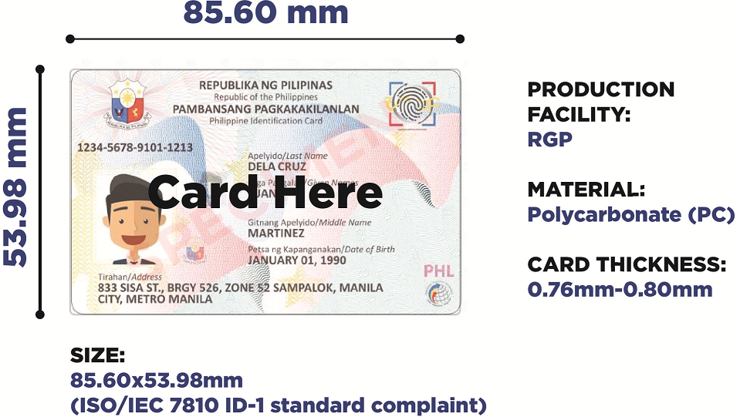
PhilID Card Production Specifications

Slide 6
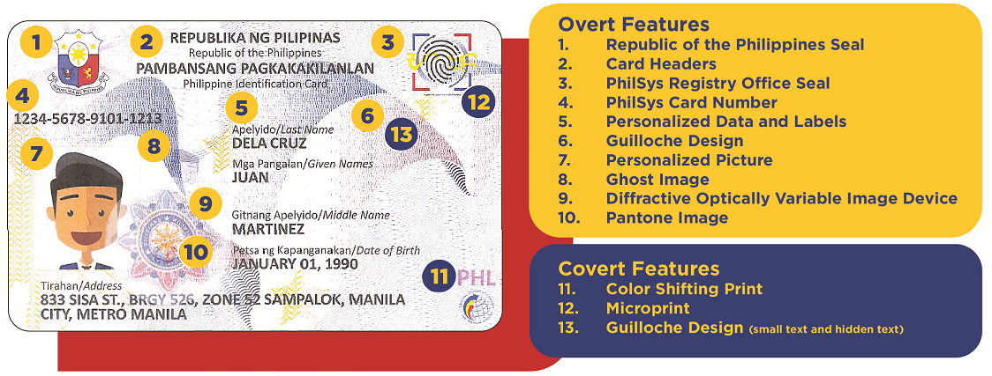
PhilID Card Design and Security Features
Front

Slide 7
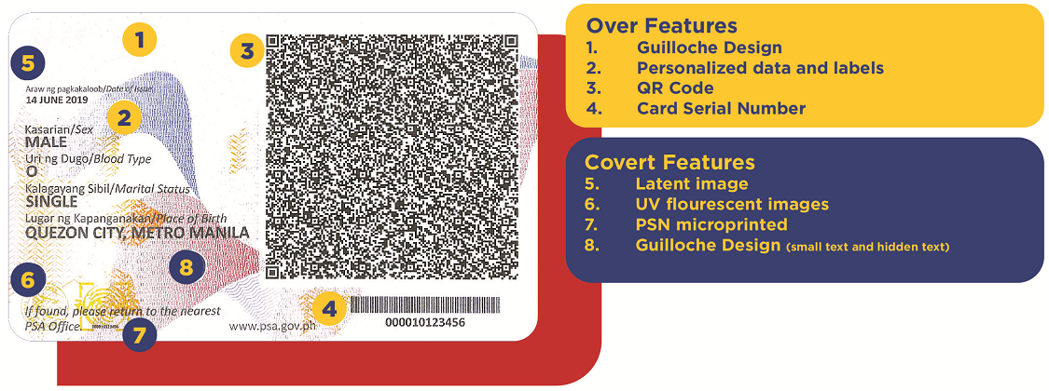
PhilID Card Design and Security Features
Back

Slide 8
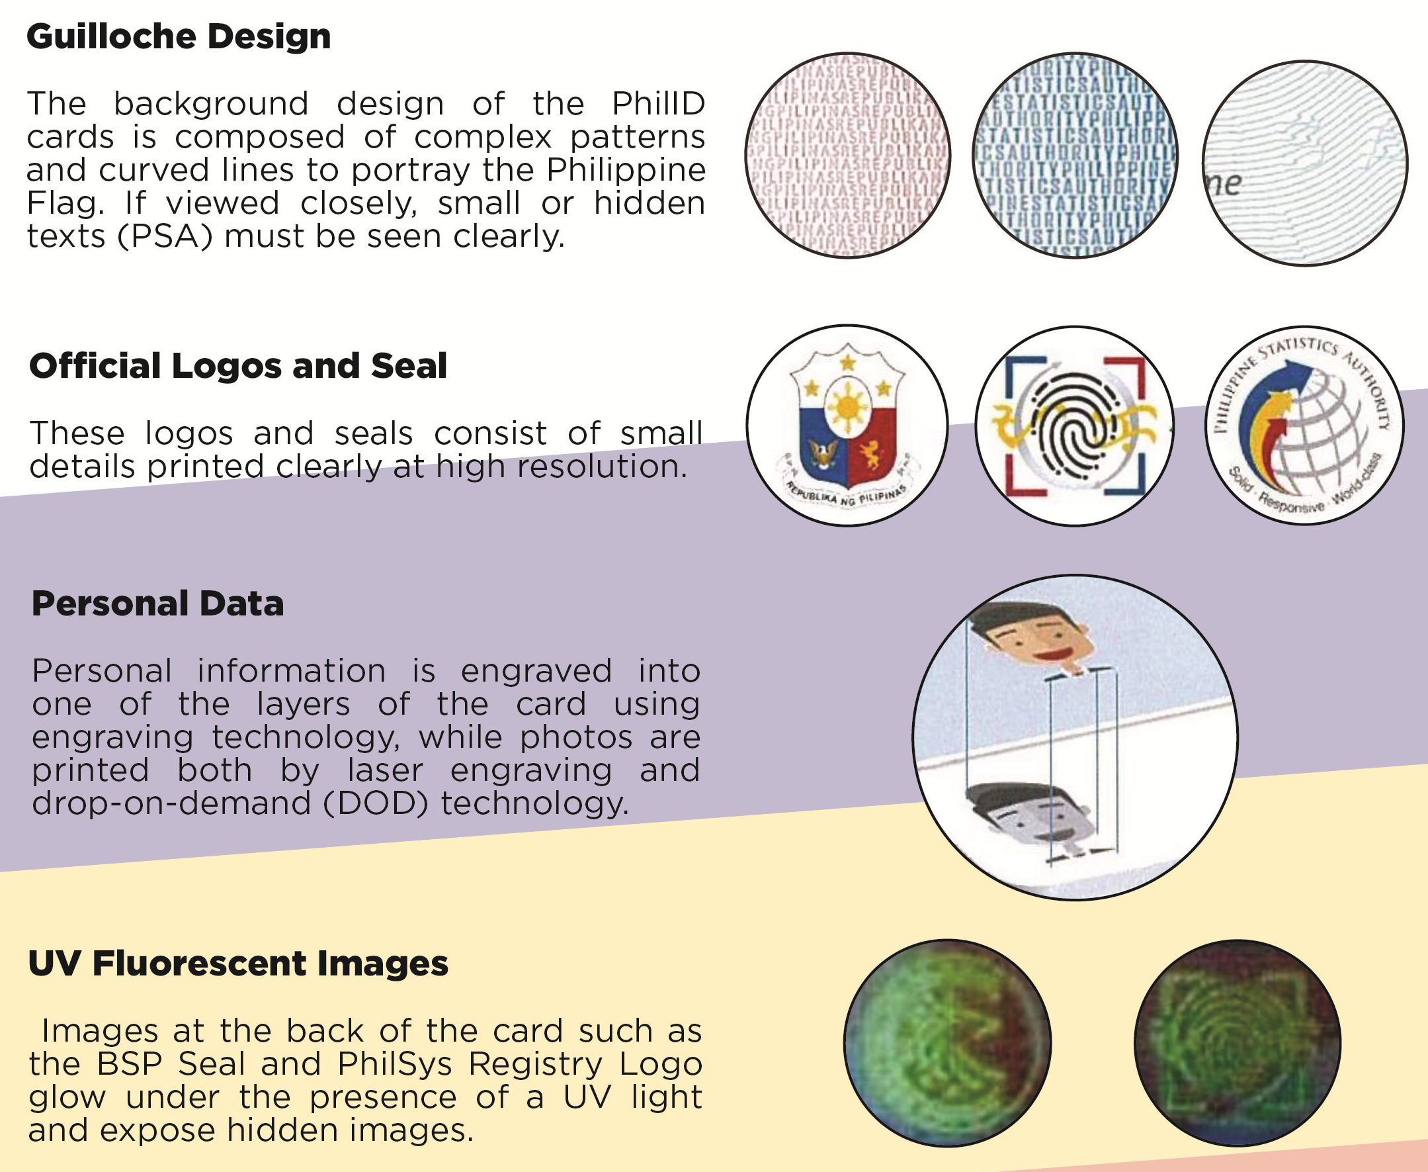
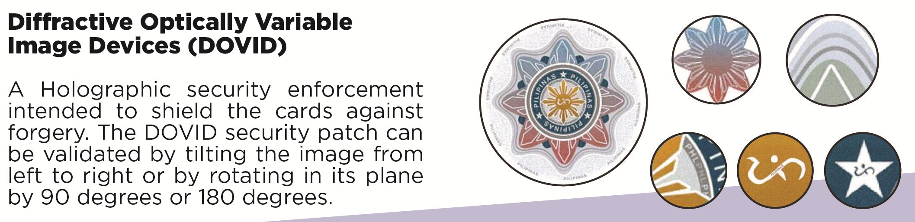
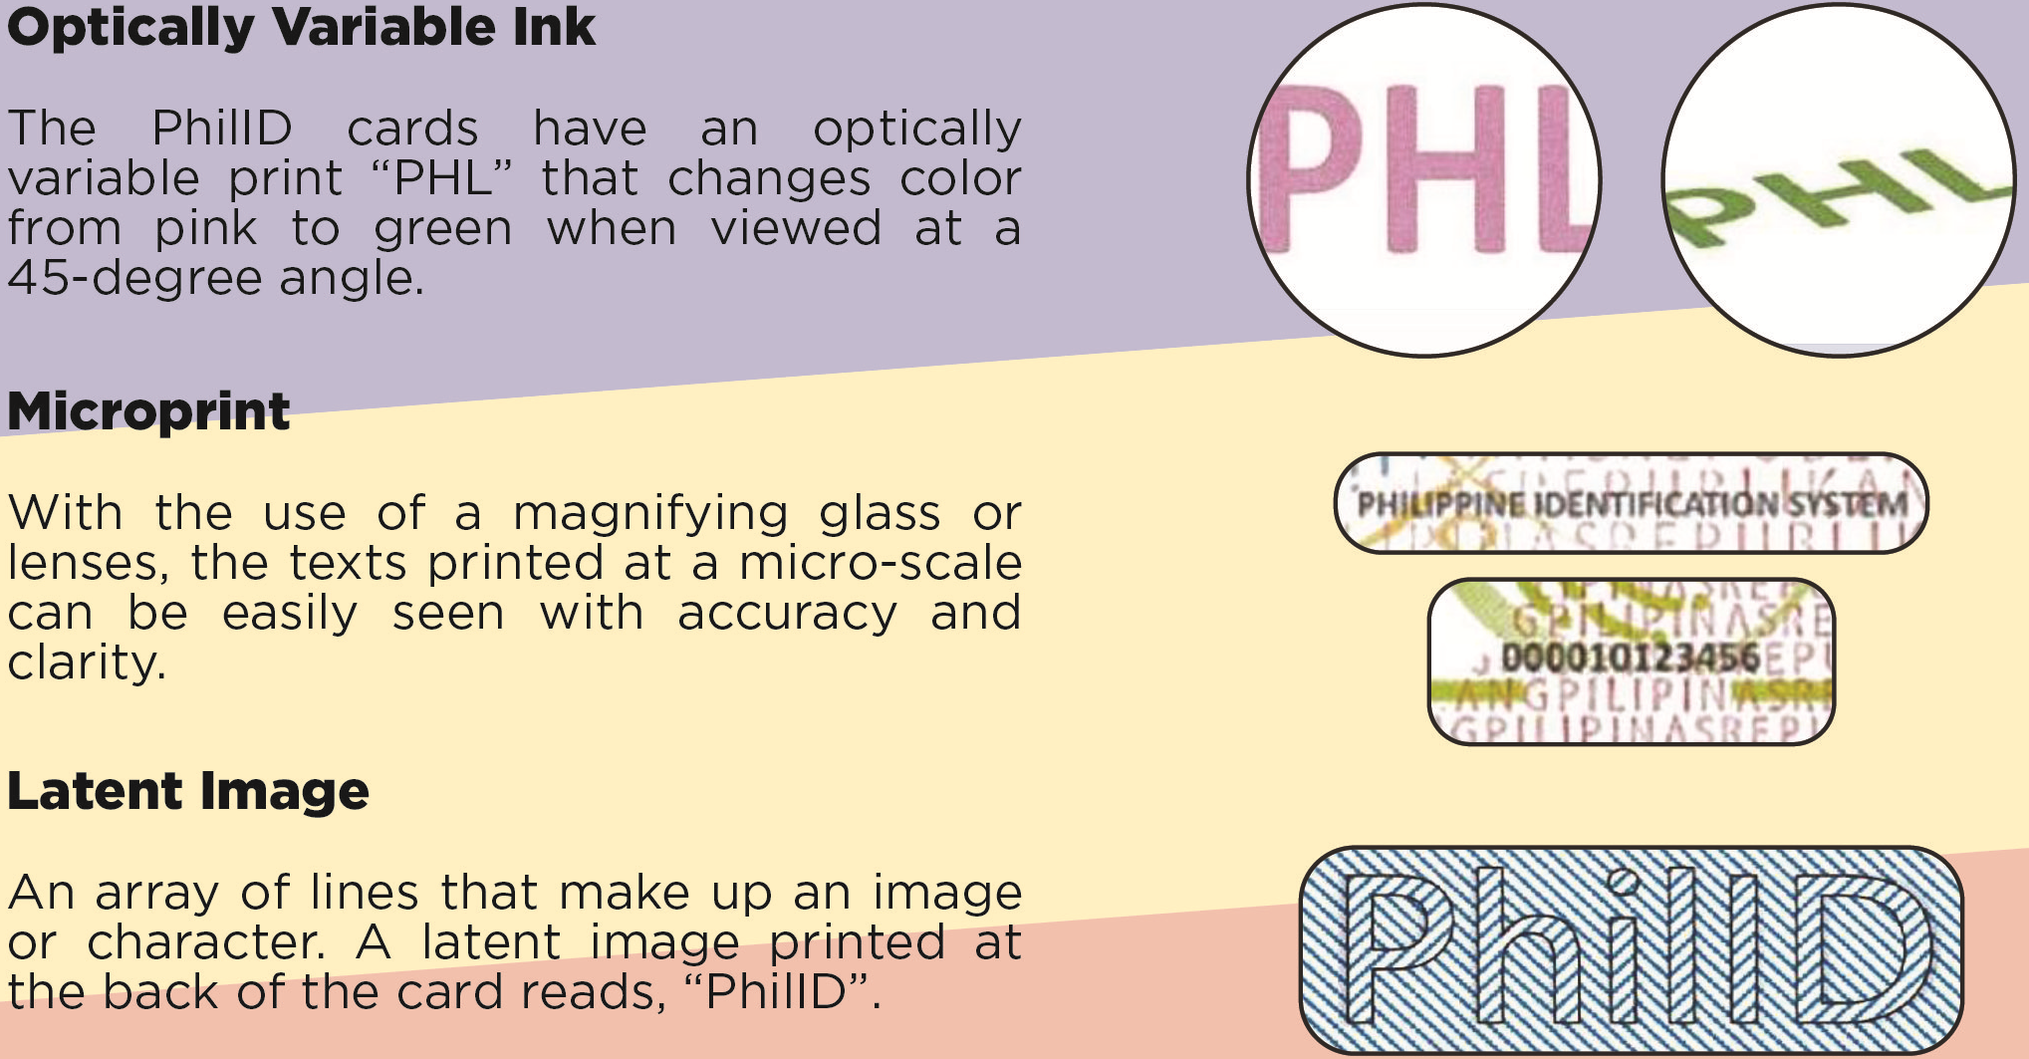
PhilID Card Design and Security Features

Slide 9
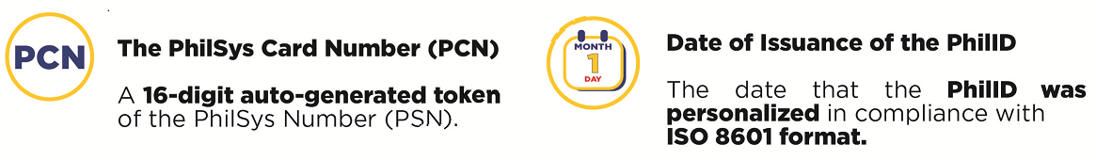
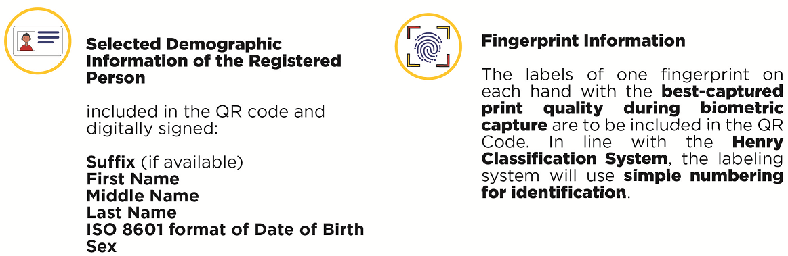
What’s in the PhilID QR Code?

Slide 10
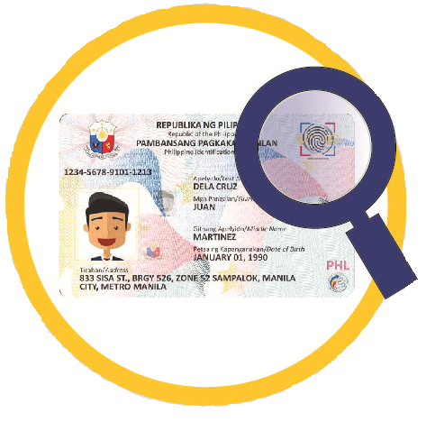
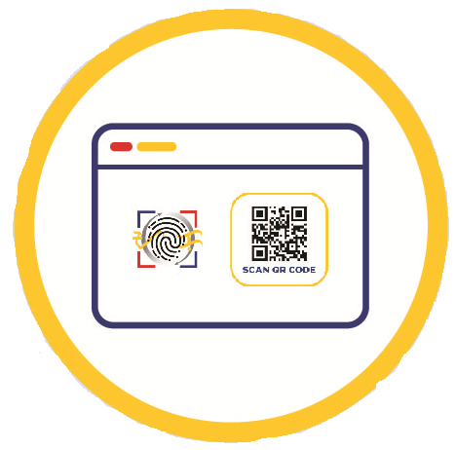
Offline Authentication
PhilID Physical Security Features
The anti-tamper features of the PhilID card, such as the ghost image of the bearer, guilloche design, and the diffractive optically variable image device, are some of the most sophisticated and secure in the Philippines.
QR Code Digital Verification
This is the scanning of the QR code through the PhilSys app and website and using asymmetric key cryptography to validate whether the client's demographic information is correct and has not been tampered with.

Slide 11
Non-inclusion of handwritten signatures in PhilID
The non-inclusion of a handwritten signature as part of the PhilID was deliberate and aligns with other national ID systems, such as in India, Singapore, Malaysia, Thailand, and Vietnam, among others. It intends to:
● Promote greater security in transactions through stronger methods of verification and lower risks of forgery;
● Incentivize the use of digital technologies and more modern approaches for identity verification; and
● Ensure the PhilID remains universally accessible and usable for all Filipinos.

Slide 12

Non-acceptance of PhilID and fines
Under Section 19 of the PhilSys Act, any person or entity who will refuse to accept or recognize the PhilID or PhilSys Number (PSN) as the only official identification of the holder, without just and sufficient cause, shall be fined an amount equivalent to five hundred thousand pesos (Php 500,000.00).

Slide 13





Webinar on PhilSys-enabled services
Thank you!
http://www.psa.gov.ph
http://openstat.psa.gov.ph
https://twitter.com/PSAgovph
https://www.facebook.com/PhilippineStatisticsAuthority

