Slide 1
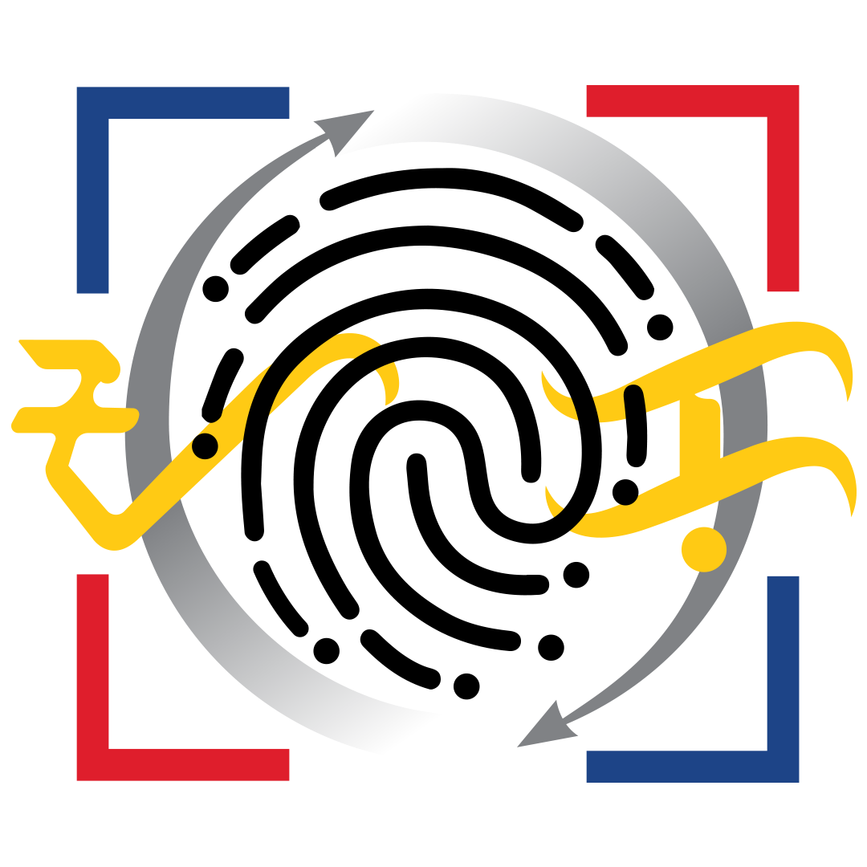
PHILSYS FOR PSA:
An Orientation on the PhilSys API-Enabled Services
RENE C. MENDOZA
Assistant National Statistician
Systems and Information Security Service
PhilSys Registry Office
PhilID 101: Webinar for PhilID Security Features and Authentication Framework
02 December 2021, 1:30 p.m. – 3:30 p.m.
Notes:
4Ps Beneficiary
UMID Card Holder
For employment

Slide 2
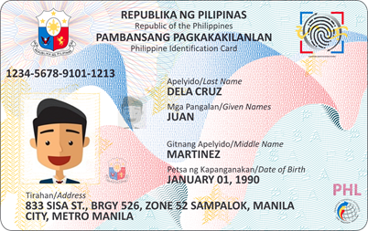
Outline of the Presentation
Registration Update
Design and Components of the PhilSys
PhilSys Functions
PhilSys as an Enabling Platform
PhilSys Credentials and Identifiers
Methods of Authentication
PhilSys API-enabled Services
Online Authentication and E-KYC Process
PhilSys QR Code Verification
What Agencies Need to Adopt to PhilSys
Developing a Digital Infrastructure Stack

Slide 3

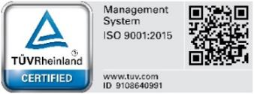

Republic of the Philippines
Philippine Statistics Authority
Registration Updates
50 to 70 million
Filipinos have a PSN/PCN by the end of 2021
Step 1 and 2 (Demographic data, Biometrics, and docs check at registration center)
1
45.9 million (as of 24 November)
6.5 million individuals onboarded for LBP Bank Accounts
Reg Center in 81 provinces; Scaling up gradually to 300+k per day
PhilID card distribution
3.8 million (as of 19 November)
Operations began in May 2021
2
Registration Updates 3

Slide 4
Design and components
of the PhilSys

Slide 5
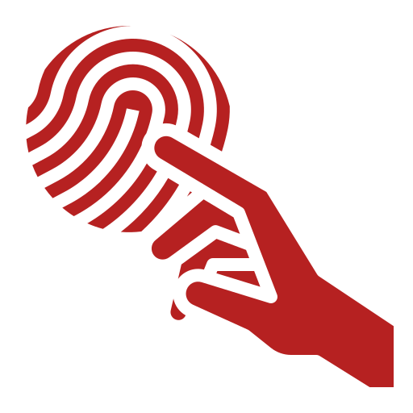
PhilSys has 2 simple functions
PSN
#
#
#
#
#
#
#
#
#
#
#
#
Creating a unique digital identity for all Filipinos and Resident Aliens (the PhilSys Number)
Providing reliable authentication of an identity for secure and digital transactions

Slide 6
PhilSys is designed as an enabling platform
PhilSys is a secure, digital and interoperable platform that uses APIs and technology to allow service providers to securely and instantly verify their clients’ identity with high assurance, and to build their applications on top.
1. Increase access to services through a universally-available ID
2. Reduce fraud by cleaning databases of duplicate and fictitious records
3. Promote ease of doing business by reducing paperwork when proving ID
PhilSys as a Platform
Notes:
PhilSys will allow government agencies and businesses, as relying parties, to transform how they provide services by shifting to transactions that are paperless, automated, and online.
This digital transformation of services will significantly reduce costs, time, and fraudulent transactions.
In the long term, it will enhance accuracy, integrity, and interoperability among relying parties.
Core technology:
Built on the Modular Open Source Identity Platform (MOSIP) framework
ABIS and authentication system for of fingerprints, irises and faces
Leveraging Open APIs for third party interfaces

Slide 7
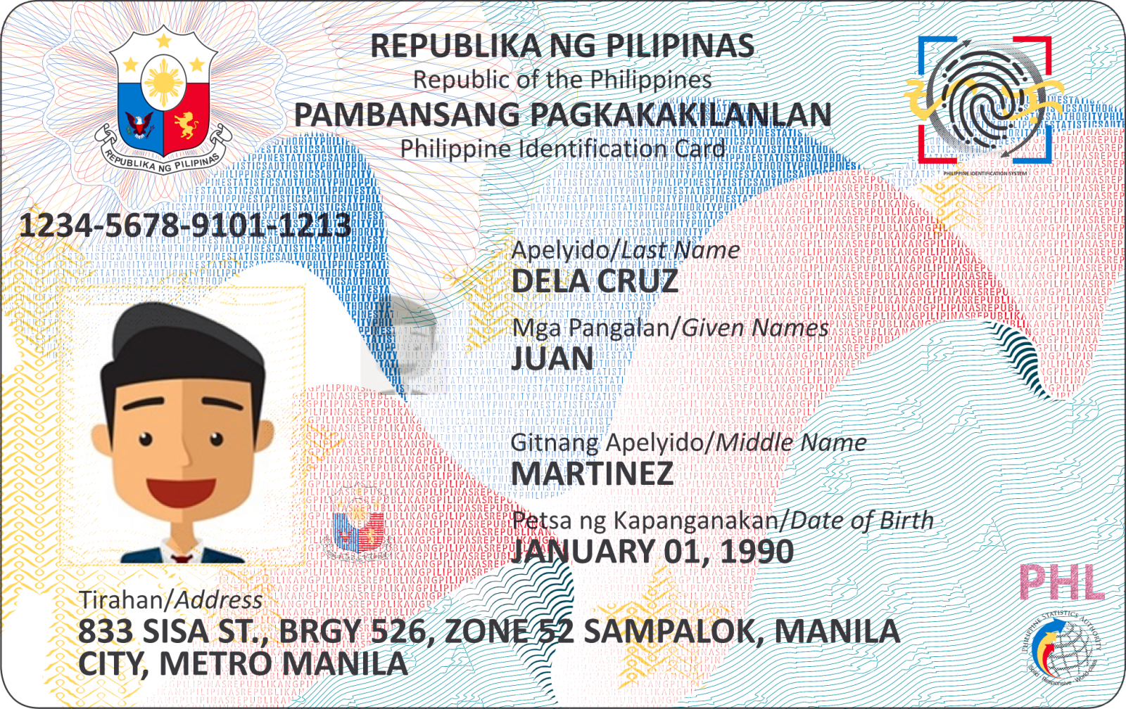
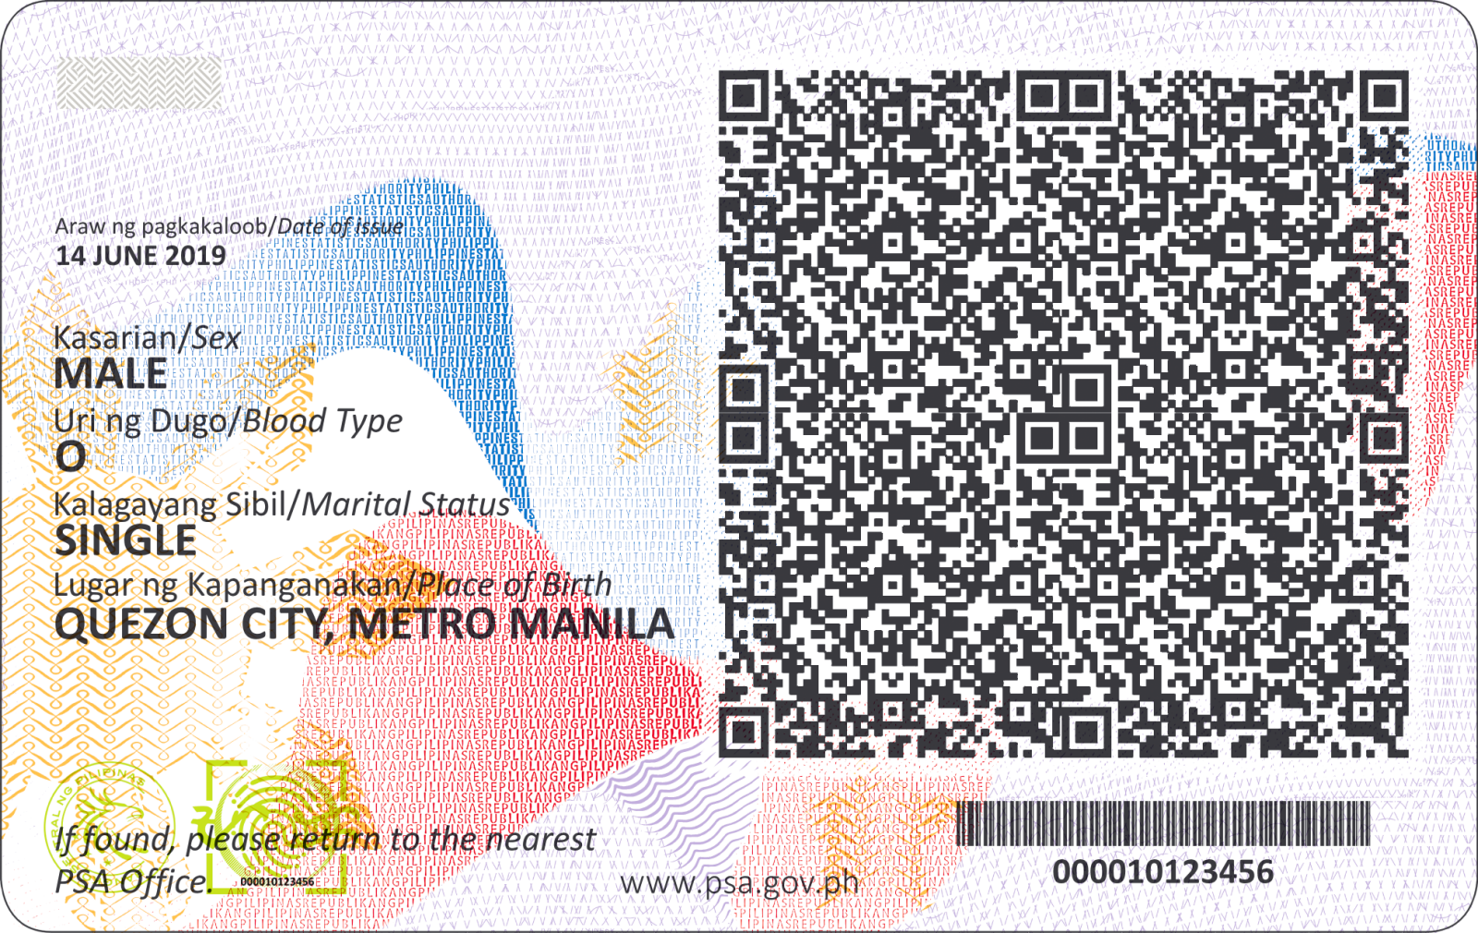
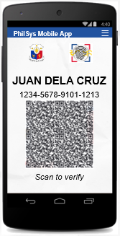

PhilSys Credentials and Identifiers
Tokens
PCN
Used for authentication
Printed clearly on and valid for the life of the PhilID
Relationship is like ATM card and bank account numbers
PhilSys Card Number
PSN
PhilID Card
PhilSys Number
Permanent 12-digit number
Kept private: Not intended to be collected or used for transactions
Microprinted on PhilID to allow holders to retrieve if and when needed
Alyas PSN
Used for authentication
Generated by the holder for a via app or portal
Similar to virtual credit card numbers
PhilSys Mobile App
Back-end tokens
Generated and seeded in databases through back-end process
Seeded in databases
Notes:
The PhilSys has the following key components:
The PhilSys Number or PSN, a randomly generated, unique, and permanent identification number that will be assigned to every citizen or resident alien upon birth or registration. The PSN, or its derivatives, shall be the standard number for the individual across all government agencies. The PSN shall also be accepted as sufficient proof of identity, subject to authentication.
Given the confidential nature of the PSN, its derivatives shall instead be used for authentication purposes. These derivatives include the PhilSys Card Number or PCN, Alyas PSN, and back-end tokens.

Slide 8

PhilSys Credentials
PhilID card:
Polycarbonate for durability
Strong physical security features (incl. ghost image) for offline verification and to reduce tampering and forgery
Both PhilID card and mobile PhilID
Digitally signed data in QR code using public-private key cryptography
PhilSys Mobile App
Scan to verify
Actual design
Mock up / Actual design will vary
Notes:
The PhilID is a non-transferable card that shall preferably be issued to all citizens or resident aliens registered in the PhilSys.
Whether in its physical form or through the mobile application, the PhilID shall serve as the government-issued identification document of cardholders in dealing with all NGAs, LGUs, GFIs, SUCs, and all private sector entities.

Slide 9




Methods of authentication
Matched against the PhilSys Registry
PCN
Name
DOB
or
or
or
or
Face
Fingerprint
Iris
SMS OTP
Demographic
Online only
Advanced anti-counterfeit security features
QR code Digital signature verification
Matched against the PhilID Card or Mobile App
PhilSys App
or
Own app
Notes:
There are two modalities of PhilSys Authentication:
The online authentication which employs the combination of PhilSys Number or tokens with different biometric identities like facial recognition, fingerprint or iris, or demographic information such as name and date of birth. One Time Password (OTP) which will be sent via SMS could also be employed.
The offline authentication, on the other hand, can be used for low-risk transactions. The Relying Party will review the PhilID and compare the information (e.g. the facial image) with that of the bearer as well as examine the quality and overt security features of the PhilID.

Slide 10





PhilSys API-enabled Services
Authentication
e-KYC
Token Seeding
Token Matching
Online or Offline
Match against information in the PhilSys Registry and/or PhilID Card and/or Mobile App
Online is only Yes/No, accessed via secure Open API connection
Online only
Authentication + sharing pre-defined data attributes from the PhilSys Registry
Can be used to pre-fill forms (e.g. applying for a subsidy) and for regulatory compliance
Incorporating PSN Tokens into databases, to establish uniqueness of a client
Used to identify fake, duplicate or deceased individuals
Matching tokens on same PSN holder across different agencies
Used to facilitate data exchange on the same individual (e.g. for verifying eligibility for a payment
Notes:
The PhilSys enabled services are the following:
Basic online authentication – a simple Yes/No verification of the claimed identity against information recorded in the PhilSys Registry.
The e-KYC (electronic Know Your Customer) – denotes the sharing of predefined data attributes from the PhilSys Registry.
PSN Tokens – unique personal identifier generated by PhilSys and linked to the PSN of the same individual. These tokens are used to protect the PSN.
4. Token Matching - Matching tokens on same PSN holder across different agencies

Slide 11


Online Authentication and E-KYC Process
1. When accessing a service online or OTC, registrant provides PCN or Alyas PSN and a biometric is scanned (or OTP requested)
2. Authentication request sent by relying party to TSP via API
PCN
TSP
(PSA initially)
3. TSP sends to PhilSys Registry, which will match biometric or OTP
4. Yes or No response returned via TSP
If e-KYC: If authentication successful, relying party will also receive name, date of birth, photo, PSN token and/or address in digital signed format, which can be used to pre-fill an application form or to store (e.g. banks keeping data for Anti-Money Laundering purposes)
PhilSys Registry
Notes:
In this slide we can see an example of eKYC transaction where a cardholder applies for a bank account. She will provide her PCN and other authentication factors such as biometric or OTP to the bank as the relying party. The bank will then request for the Authentication of the submitted identity to the PhilSys registry via API. The PhilSys will match the submitted biometric against the registry and if the match is successful, the bank will receive specific information to pre-fill their form and store. This transaction will take around 5-10 seconds, which significantly reduces the processing time spent by Relying Parties.

Slide 12
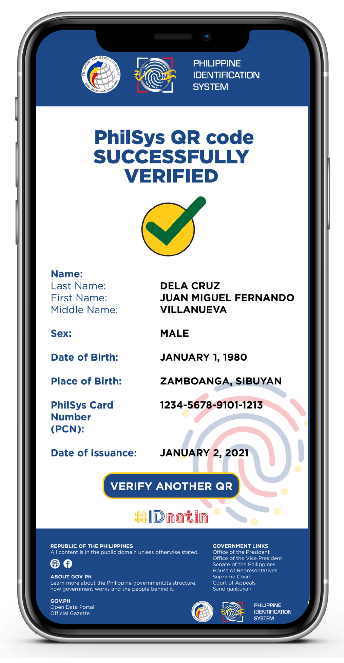
PhilSys QR Code Verification
Public keys for verification of the digital signature will be distributed to relying parties. Details will follow soon.
PSA will also build a PhilSys QR Code Verification System (website) for public use:
URL: https://verify.philsys.gov.ph
Enables a RP to verify the integrity of the data encoded in the QR code of PhilIDs (demographic only) and mPhilIDs (demographic [and possibly photo])
Under Pilot Testing (05-26 November 2021)

Slide 13
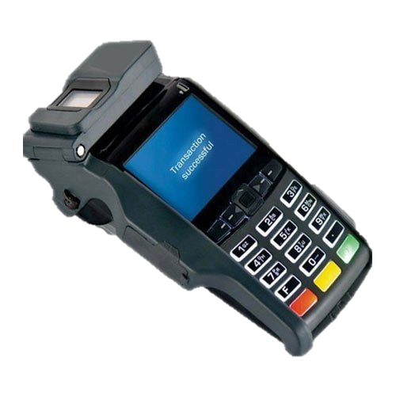
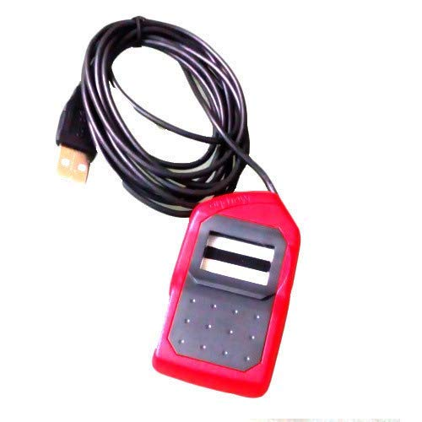


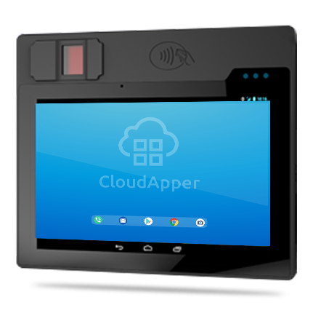
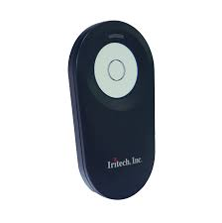


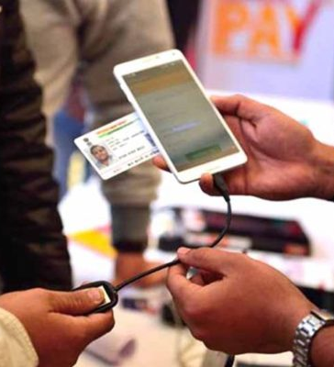
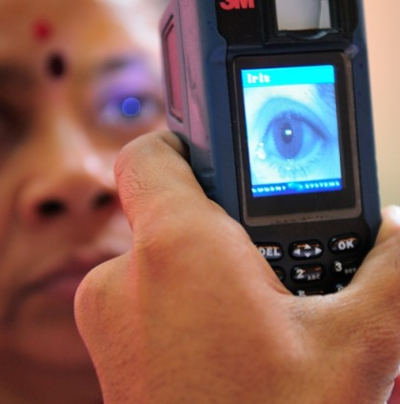

What Agencies Need to Adopt PhilSys
Plan for adoption of PhilSys authentication, e-KYC and seeding
Sign standardized MOA with PSA
Interface software and systems with PhilSys through open APIs
Procure verification devices that meet PhilSys standards
Notes:
In order to adopt the PhilSys and make use of its services, relying parties shall send an official letter of intent to the PSA. The appropriate Use Cases Division shall organize a series of meetings with the relying party to ensure their readiness and efficient operationalization of the use case.
The relying party shall enter into a Memorandum of Agreement with the PSA. For the CRS pilot however, a MOA will no longer be executed.
Next comes the development and/or interfacing of systems with the PhilSys through open APIs.
The biometric authentication devices that comply with the PhilSys standards shall also be procured.

Slide 14


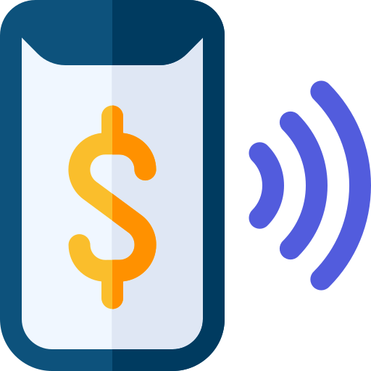
Developing a digital infrastructure stack
The PhilSys is the foundational platform for unlocking many types of transactions that are necessary in digital economies and societies, saving people, government and businesses time and money, and unlocking new drivers of economic value and growth.
Consumer empowerment
Consented data sharing and control
Paper-less transactions
Ease of doing business
Cash-less transactions
Digital payments
Presence-less transactions
PhilSys-enabled authentication and e-KYC
Notes:
The PhilSys is the foundational platform for unlocking many types of transactions that are necessary in digital economies and societies, saving people, government and businesses time and money, and unlocking new drivers of economic value and growth.
These are the added benefits of leveraging on the PhilSys-enabled authentication and e-KYC.

Slide 15







Republic of the Philippines
Philippine Statistics Authority
Thank you!
http://www.psa.gov.ph
http://openstat.psa.gov.ph
https://twitter.com/PSAgovph
https://www.facebook.com/PhilippineStatisticsAuthority

